Slide 1
PHYSICS 3610 Thermodynamics
Fall 2013

Slide 2
Course Outline
Syllabus review
Office hours
Two sections to the course: Engineering Thermodynamics & Statistical Mechanics
Actually 2 courses PHYSICS 3510 & PHYSICS 3610
Grading
  Test 1 25%
  Test 2 25%
  Final Exam 25%
  Homework 25%
Text book: An Introduction to Thermal Physics by Daniel Schroeder

Slide 3
Homework Format
Start each problem on a new page.
Use paper without a ragged edge—copy paper or lined paper
Number the problem clearly.
Outline the problem briefly—give the values of parameters from the problem with the symbol you assign.
List the parameters and solve using clear mathematical reasoning.
Hand in at the beginning of the class it is due.

Slide 4
What is thermodynamics?
Thermal physics is the study of the interactions of macroscopic systems of particles as energy is exchanged between them.
Thermodynamics is the study of the change in macroscopic properties of a system involving heat.
  Macroscopic properties means pressure, volume, temperature, internal energy, entropy…
  Thermodynamics does not typically address the atomic/molecular aspects of the system
  “Engineering” discipline—useful (vital?) for understanding and solving real world problems.

Slide 5
What is Statistical Mechanics?
The study of systems at the microscopic level involving heat.
  Microscopic parameters—molecular speed, molecular kinetic energy, molecular momentum, quantum mechanical energy levels…
  “Statistical” because we typically study the properties of a large distribution of microscopic quantities.
  Stat. Mech. is more about understanding than solving problems.
  Example of Entropy.

Slide 6
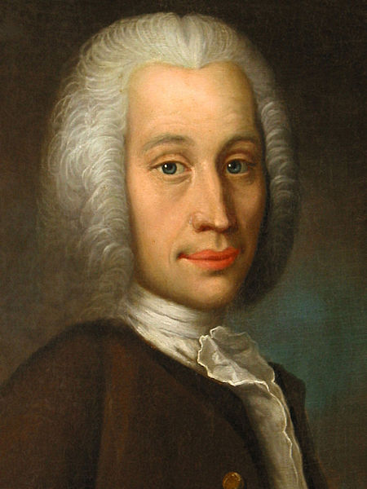
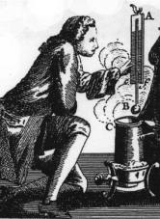
Temperature and Temperature Scales
What is temperature?
  A measure of the hotness or coldness of an object.
  A measure of the energy in an object.
  An indicator of the direction and rate that heat will flow between two objects of different temperatures in contact.
Lower bound of temperature and the Kelvin scale.
Temperature scales and conversion
  Derive the formula for conversion of Celsius to Fahrenheit
  Derive the formula for conversion of Kelvin to Fahrenheit

Slide 7
The Zeroth Law of Thermodynamics.
If system A is in thermal equilibrium with system B, and system B is in thermal equilibrium with system C, then system A is in thermal equilibrium with system C.
Seems pretty obvious. Why is it the zeroth law?
Importance: Thermometers

Slide 8
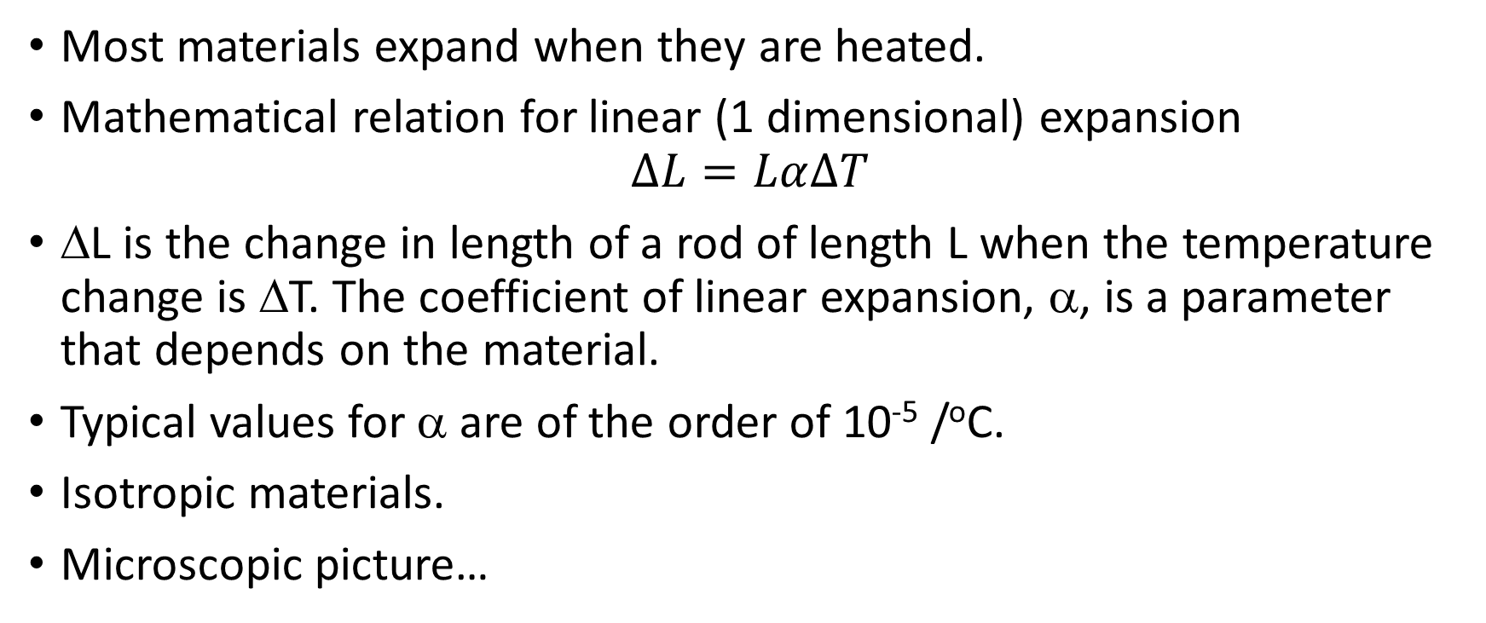
Thermal Expansion
Most materials expand when they are heated.
Mathematical relation for linear (1 dimensional) expansion
$$∆L=Lα∆T$$
ΔL is the change in length of a rod of length L when the temperature change is ΔT. The coefficient of linear expansion, α, is a parameter that depends on the material.
Typical values for α are of the order of 10⁻⁵ /ºC.
Isotropic materials.
Microscopic picture…

Slide 9
Expansion in two and three dimensions
Derive the relation ΔA = 2αAΔT for an isotropic plate of length L and width W having a coefficient of linear expansion α.
Derive the relation ΔV = 3αVΔT for an isotropic plate of length L and width W and height H having a coefficient of linear expansion α. This relation is more conventionally written ΔV = βVΔT where β is the coefficient of volume expansion.

Slide 10
Examples
Consider a spherical drop of mercury having a radius of 4.000 mm at 0ºC. What is the radius of the drop at 100ºC? (α for mercury is 61 x 10⁻⁶ m/m.K)
A circular hole in an aluminum plate is 2.540 cm in diameter at 0ºC. What is its diameter at 100ºC? (α for Al is 22.2 x 10⁻⁶ m/m.K)
Discussion points:
  Railroad tracks and the gap between rails
  Sag of phone and electrical lines
  Invar

Slide 11
Heat Capacity
Heat capacity, C, relates the change in temperature of an object when heat is added or removed.
Specific heat capacity, c, is the heat required to change the temperature of a specific mass of material (1 gram or 1 kilogram) by 1 degree (Celsius).
  Heat capacity of water 4184 J/kg.K in MKS units.
  Heat capacity in other units 1 calorie = 4.184 J. Heat required to raise 1 g of water by 1 ºC.
  Note: Food “calories” are (disappointingly) really Kilo-calories.
Molar heat capacity, c_{M}, is the heat required to change the temperature of 1 mole of material by 1 degree (Celsius).

Slide 12
The Mole
6.02 x 10²³
Technically the same number of elementary entities (atoms, molecules..) as 12 grams of pure carbon.
I presume you know this…

Slide 13
Specific heat capacities of common materials
Substance | Specific Heat (J/kg·Cº)
aluminum | 900
copper | 387
ice | 2,060
lead | 128
silver | 235
ethyl alcohol | 2450
mercury | 138
water | 4186
air | 1005
oxygen | 912
steam | 2009

Slide 14
C_{P} and C_{V}
Heat capacity can be measured for a material at constant volume or constant pressure.
Why might these be different? Imagine an experiment to find the heat capacity of a solid. How about a gas? We will do much with this concept soon.
Which would you expect to be greater, C_{P} or C_{V}?

Slide 15
Heats of transformation
When a material undergoes a phase change—solid-to-liquid or liquid-to-vapor—heat energy is required without a change in temperature.
Q=mL
m=mass of material changing phase and L = the latent heat of fusion or vaporization as applicable.
Example: Water L_{F} = 334 kJ/kg L_{V}=2260 kJ/kg
First—note the units are kJ not J.
Second—we need to account for the sign of the latent heat term explicitly depending on the circumstances. Ask if heat is input or output in order to melt or vaporize

Slide 16
Example
How much energy would it take to heat up a cube of ice 1.0-cm on a side from an initial temperature of – 20ºC to a final temperature of 350 K? The density of ice is 917 kg/m³.

Slide 17
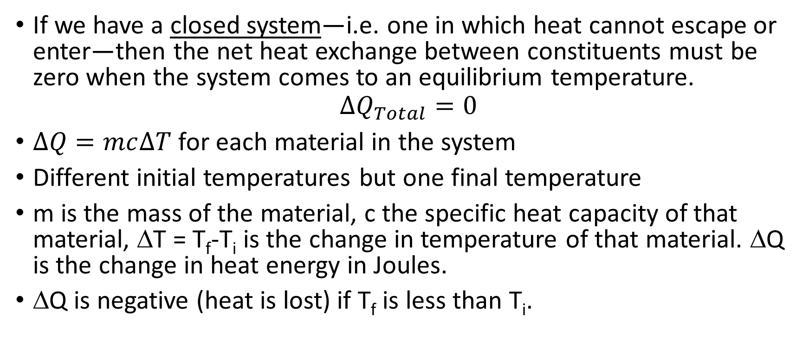
Calorimetry
If we have a closed system—i.e. one in which heat cannot escape or enter—then the net heat exchange between constituents must be zero when the system comes to an equilibrium temperature.
$$∆Q_{Total}=0$$
$∆Q=mc∆T$ for each material in the system
Different initial temperatures but one final temperature
m is the mass of the material, c the specific heat capacity of that material, ΔT = T_{f}-T_{i} is the change in temperature of that material. ΔQ is the change in heat energy in Joules.
ΔQ is negative (heat is lost) if T_{f} is less than T_{i}.

Slide 18
Example
A 150 g copper bowl contains 420 g of water, both at 20.0 ºC. A hot 300 g iron rod is dropped into the water, which is then stirred until a uniform steady-state temperature is reached. This final temperature is found to be 55.7ºC. Assume that the entire system is isolated from its environment. (The specific heat of iron is 0.107 cal/g.K. Cu is 390 J/kg.K)
(a) What was the original temperature of the iron rod?
(b) What is the heat capacity of the copper bowl?
(c) What is the molar specific heat of the water?
(d) Do you think that the molar specific heat calculated in (c) is c_{p} or c_{v}?

Slide 19

Thermal Conduction
At what rate does heat flow from hot (T_{H}) to cold (T_{C})across some intervening material?
$$P=\frac{Q}{t}=\frac{kA(T_{H}{−T}_{C})}{L}$$

Slide 20
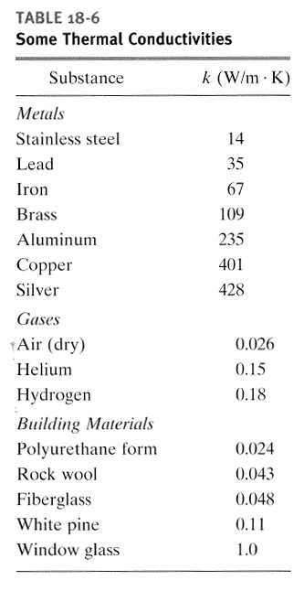

Slide 21
Combining Thermal conducting materials
What is the temperature at the junction?
What is the condition that must apply?

Slide 22
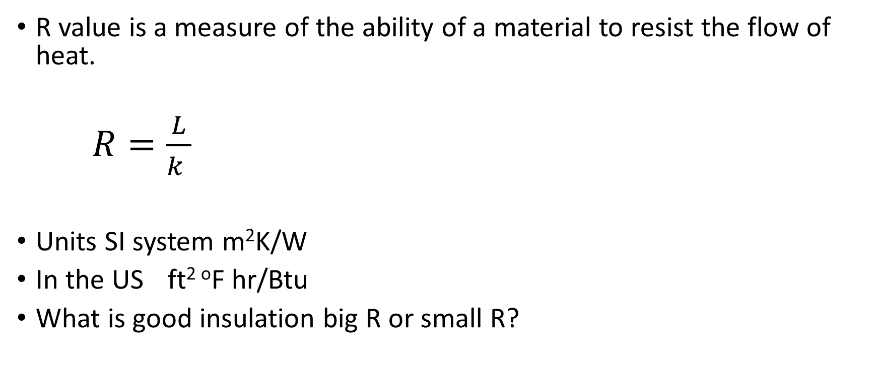
R value and thermal insulation
R value is a measure of the ability of a material to resist the flow of heat.
$R=\frac{L}{k }$
Units SI system m²K/W
In the US ft^{2 o}F hr/Btu
What is good insulation big R or small R?

Slide 23
Example
A cylindrical copper rod of length 1.2 m and cross-sectional area 4.8 cm² is insulated to prevent heat loss through its surface. One end of the rod is in a mixture of boiling water and steam, and the other end is in a water-ice mixture that is constantly but slowly stirred to keep the mixture uniform. At what rate is ice melting at the cold end?

Slide 24
Temperature Reservoir
In the previous example the hot and cold ends did not change temperatures even through heat was flowing between them.
This effect is an example of a temperature reservoir—i.e. a source or sink of heat with so much energy that the amount flowing out of or into does not appreciably change the temperature of the reservoir.
A fridge uses the interior of your home as its temperature reservoir.
The concept is a frequently used construct in setting up problems in thermodynamics.

Slide 25
Work and Heat
Heat—traditionally given the symbol Q—represents thermal energy flow into a system. Flow into a system has positive Q.
Work—traditionally given the symbol W—represents energy flow due to work done on a system. Work done on a system has positive W.
The bad news—engineers (including Halliday & Resnick) use the definition of work as energy flow due to work done by the system i.e. work done on a system in this definition has negative W.
We’re going to use the physicists definition which means conflicts with the sign of W in the book answers and the statement of the 1st Law.

Slide 26
Thermodynamic state & thermodynamic process
Thermodynamic state: A specific configuration of a system defined by its thermodynamic parameters—pressure, temperature, volume etc.
The state variables such as pressure, volume, temperature define the system. (We will add state variables Internal energy and entropy).
A thermodynamic process takes a system from one state to another by changing the internal energy of the system.

Slide 27
Model system: Gas in a piston
If the gas expands a small distance dx what work is done on the gas?
To get the correct sign ask—does the internal energy of the gas go up or go down.
Remember: our definition is opposite to Halliday & Resnick.

Slide 28
PV diagrams
From 1 to 2: Expansion under constant pressure. Isobaric process.
Is work done? Positive or negative?
From 2 to 3: Reduction of pressure at constant volume. Isometric, Isochoric, Isovolumetric (3 names!).
How would we get the system from 2 to 3? Is work done?
From 3 to 1: back to the beginning by a different path. If at constant T: Isothermal.

Slide 29
PV Diagrams
What is the meaning of the area under the curve from 1 to 2?
What is the meaning of the area enclosed in the loop 1 to 2 to 3?
What can we say about the internal energy of the gas when it gets back to 1?

Slide 30
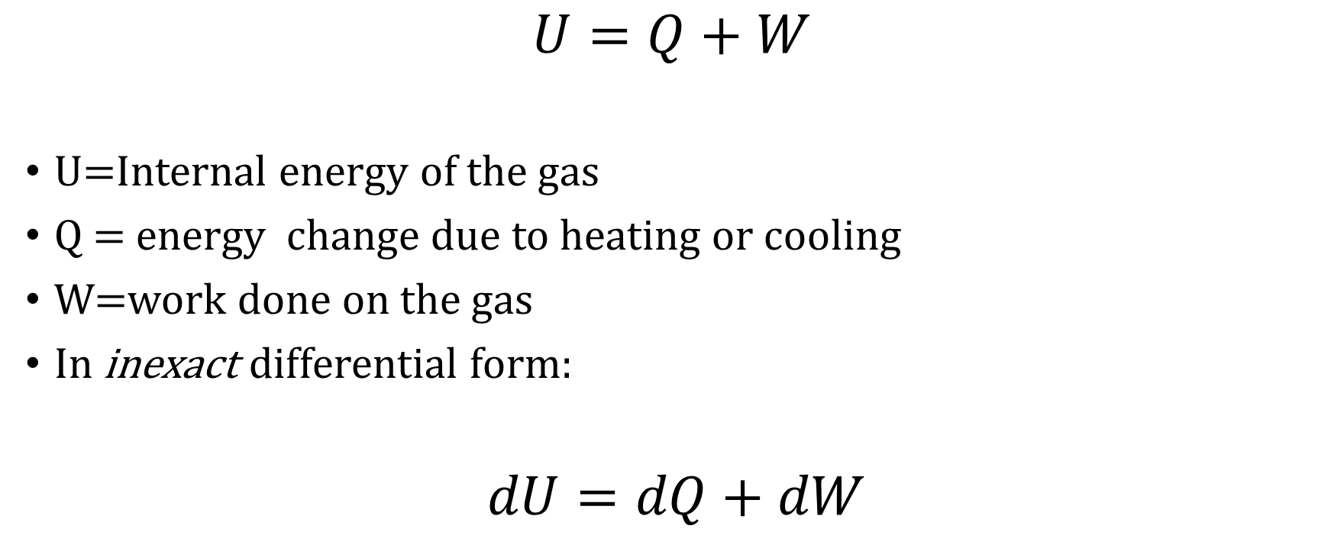
First Law of Thermodynamics
$$U=Q+W$$
U=Internal energy of the gas
Q = energy change due to heating or cooling
W=work done on the gas
In inexact differential form:
$dU=dQ+dW$

Slide 31
Example
A 10 m³ volume of liquid is supplied with 100 kcal of heat and is allowed to expand at a constant pressure of 10 atm to a final volume of 10.2 m³.
(a) Sketch this process on a PV diagram.
(b) Find the work done by the liquid on its environment.
(c) Find the change in the internal energy of the liquid.

Slide 32
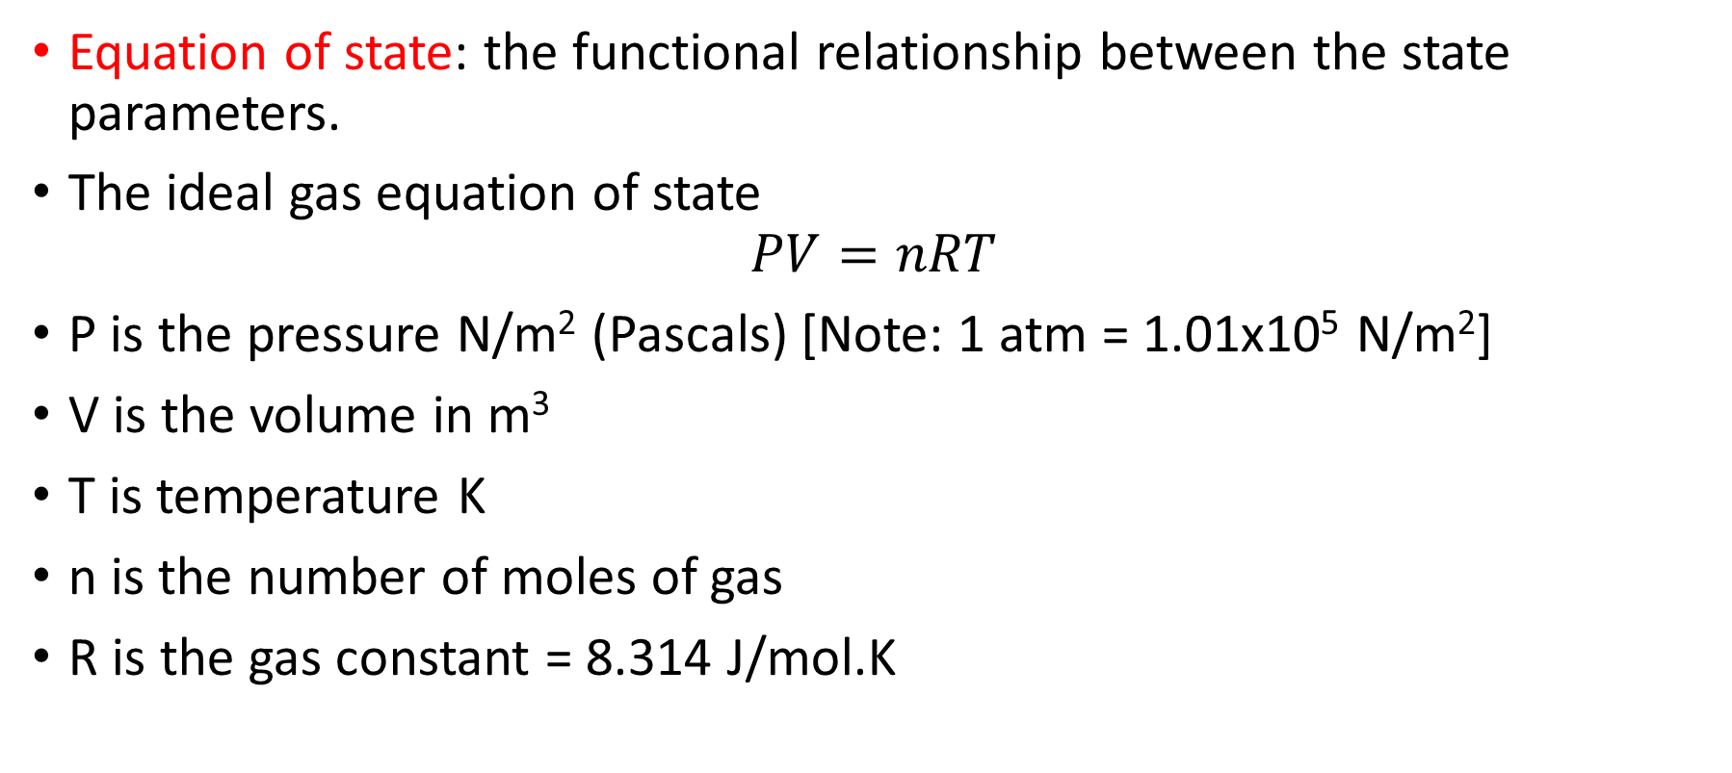
Ideal Gas
Equation of state: the functional relationship between the state parameters.
The ideal gas equation of state
$$PV=nRT$$
P is the pressure N/m² (Pascals) [Note: 1 atm = 1.01x10⁵ N/m²]
V is the volume in m³
T is temperature K
n is the number of moles of gas
R is the gas constant = 8.314 J/mol.K

Slide 33
Example
A gas consists of 7.3 g of diatomic hydrogen gas at a temperature of 320 K. The gas is allowed to expand isothermally to twice its initial volume. Assume the gas acts as an ideal gas.
(a) Sketch this process on a PV diagram.
(b) Compute the work done on the gas by its environment during this process, W.

Slide 34
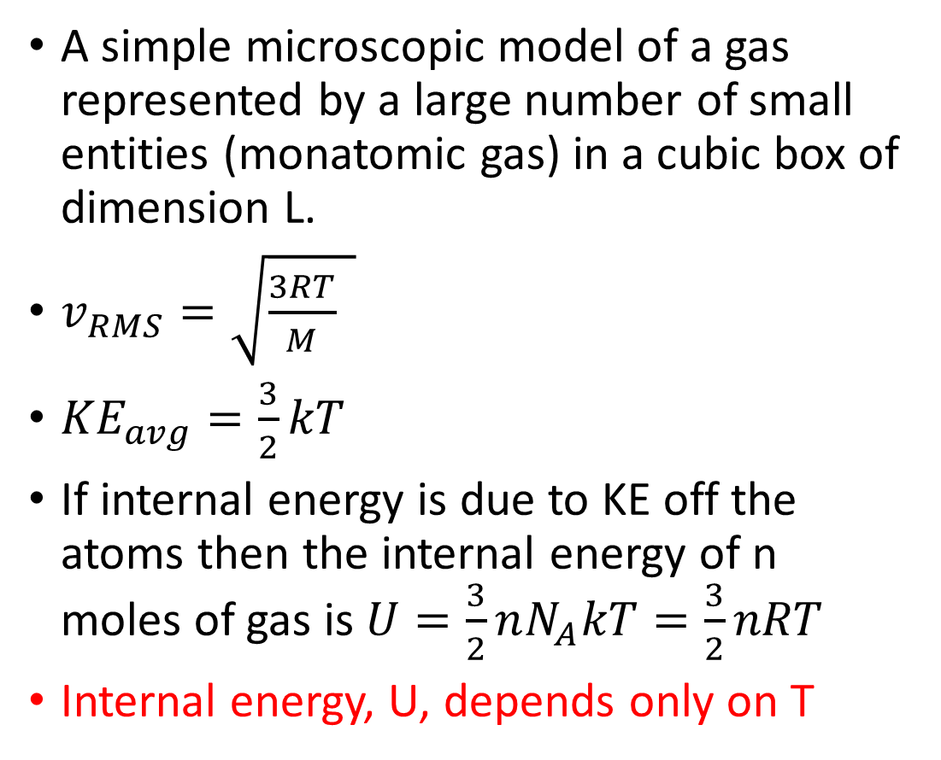
Kinetic Theory of Gases
A simple microscopic model of a gas represented by a large number of small entities (monatomic gas) in a cubic box of dimension L.
$v_{RMS}=\sqrt{\frac{3RT}{M} }$
${KE}_{avg}=\frac{3}{2}kT$
If internal energy is due to KE off the atoms then the internal energy of n moles of gas is $U=\frac{3}{2}nN_{A}kT=\frac{3}{2}nRT$
Internal energy, U, depends only on T

Slide 35
PV thermodynamic processes at constant
PV = nRT but if T is constant then P= constant/V
Isotherm Change in pressure/volume keeping T constant
The internal energy of the gas is the same at any point on an isotherm.
To change from one internal energy to another requires changing from one isotherm (T₁) to another T₂.
Many ways to move: isometric, isobaric, adiabatic

Slide 36
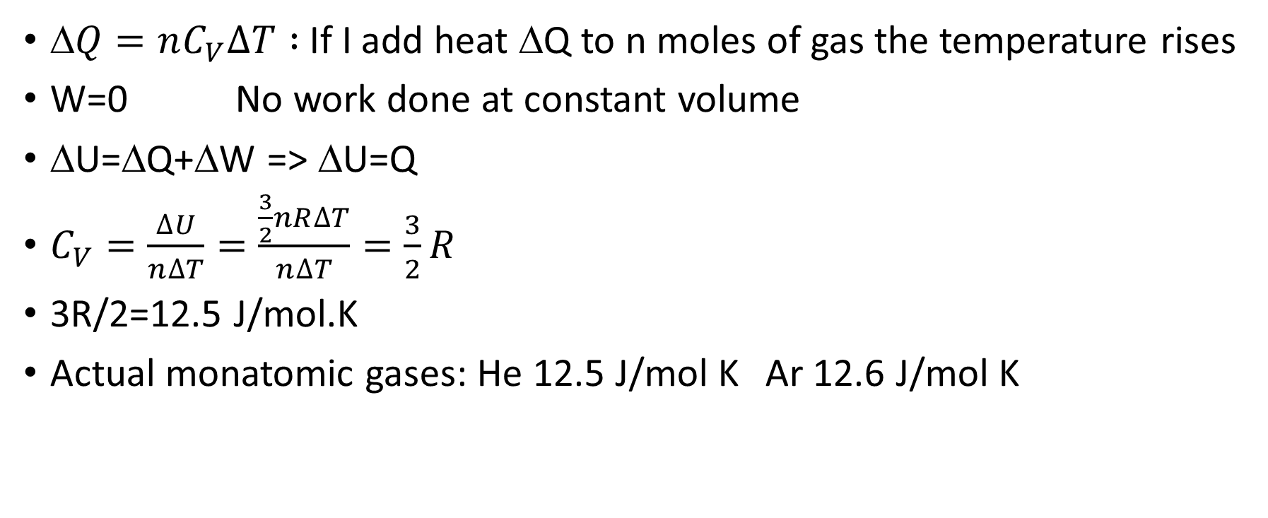
C_{V}: Molar specific heat at constant volume
$\text{D}Q=nC_{V}∆T :$If I add heat ΔQ to n moles of gas the temperature rises
W=0 No work done at constant volume
ΔU=ΔQ+ΔW => ΔU=Q
$C_{V}=\frac{∆U}{n∆T}=\frac{\frac{3}{2}nR∆T}{n∆T}=\frac{3}{2}R$
3R/2=12.5 J/mol.K
Actual monatomic gases: He 12.5 J/mol K Ar 12.6 J/mol K

Slide 37
C_{P}: Molar specific heat at constant pressure
We want to find molar specific heat, C_{P}: ΔQ = nC_{P}ΔT
Work is done ΔW=-PΔV=-nRΔT (using PV=nRT)
1st Law of Thermodynamics ΔU=ΔQ+ΔW
ΔU = nC_{V}ΔT because that gives the energy to change from one isotherm to another—one internal energy value to another
nC_{V}ΔT = nC_{P}ΔT - nRΔT which means that C_{V} = C_{P} - R

Slide 38
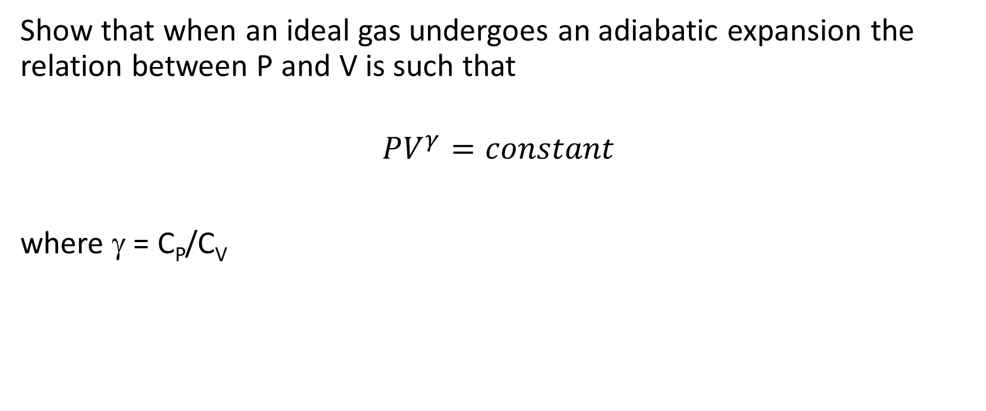
Example
Show that when an ideal gas undergoes an adiabatic expansion the relation between P and V is such that
$$PV^{γ}=constant$$
where γ = C_{P}/C_{V}

Slide 39
PV Plots for Isothermal and Adiabatic Processes
Using the Ideal Gas law, sketch the path of an isothermal expansion between two states.
Using PV^{γ}=constant do the same for an adiabatic transition between states.
What are the slopes of the isothermal and the adiabatic transitions? Which is steeper?

Slide 40
Equipartition of Energy & Degrees of Freedom
Energy in the kinetic theory of gases will be divided equally divided between all the excitations that can contain energy
Monatomic elements
  3 translational degrees of freedom ½ mv_{i}²
  C_{V}=3/2 R C_{P}=5/2 R
Diatomic elements
  3 translational degrees of freedom ½ mv_{i}² and two rotational degrees ½ Iω_{i}²
  C_{V}=5/2 R C_{P}=7/2 R
  There are also 2 vibrational degrees of freedom. However, these only appear at high temperatures because they are quantized.

Slide 41
A New State Variable: Entropy
If I show a video of an ice cube spontaneously forming at the top of a glass of water, you should know that there is some trickery involved: the video was played backwards.
From the state variables we have so far there is no reason why this should not happen in a closed system. The energy is the same with the ice melted or solid. There must be some other state variable that dictates the direction of thermodynamic processes.
That state variable is ENTROPY, typically given the symbol, S.

Slide 42


Slide 43
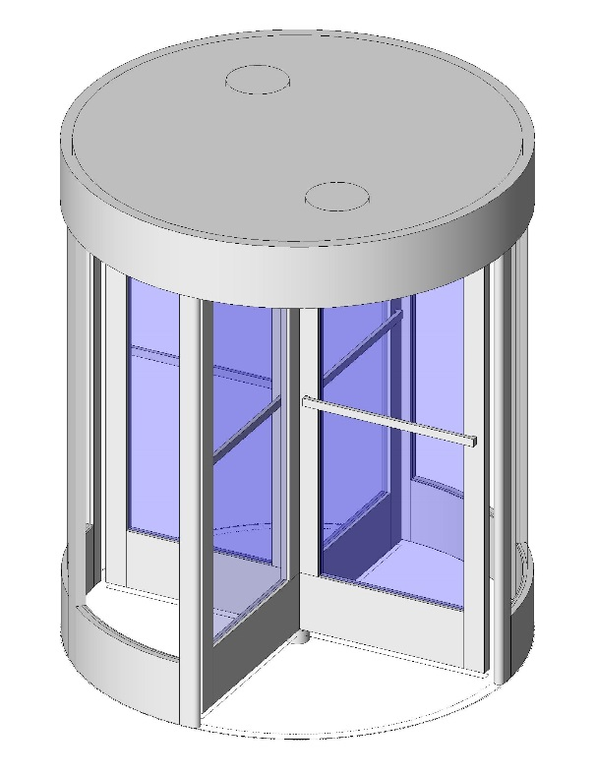
Reversible and Irreversible Processes
Reversible process: a slow change in small steps from one thermodynamic state to the next. The process can be reversed by a change in the environment.
Irreversible process: a change that cannot be reversed by a change in the environment. A process that happens too fast to allow thermodynamic equilibrium between each successive step.
Real world changes are irreversible—reversible processes are a useful means for calculation that can be approached under idealized conditions.

Slide 44
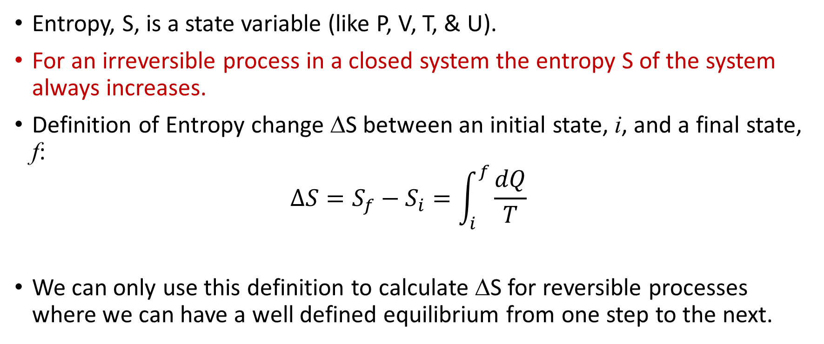
Entropy and the Direction of Thermodynamic Processes
Entropy, S, is a state variable (like P, V, T, & U).
For an irreversible process in a closed system the entropy S of the system always increases.
Definition of Entropy change ΔS between an initial state, i, and a final state, f:
$$∆S=S_{f}−S_{i}=\int_{i}^{f}{\frac{dQ}{T}}$$
We can only use this definition to calculate ΔS for reversible processes where we can have a well defined equilibrium from one step to the next.

Slide 45
Example
Find the change in entropy for an isothermal transition at T = 320 K along the path 1 - 2 in the PV diagram where the total heat injected is Q₁₂ = 460 J.
Find the change in entropy along the path 1-3-4-2.
If I go from state 1 to state 2 via an irreversible process, which I can’t show on a PV diagram (as the intermediate states are not well defined), can I still find the entropy change? If so what is it?

Slide 46
Entropy as a State Variable
If entropy is a state variable then it has the same value for a given state irrespective of how the state was created.
We can show that S is a state variable for an ideal gas by showing that ΔS = 0 around a closed path.

Slide 47
Example
A hot brick of temperature, T_{H}, is placed in contact with an identical cold brick of temperature, T_{C}.
Heat flow until the bricks are in thermal equilibrium.
Is this a reversible or an irreversible process?
Let’s calculate the change in entropy.

Slide 48
Free expansion of a gas
Free expansion of a gas from V₁ to V₂.

Slide 49
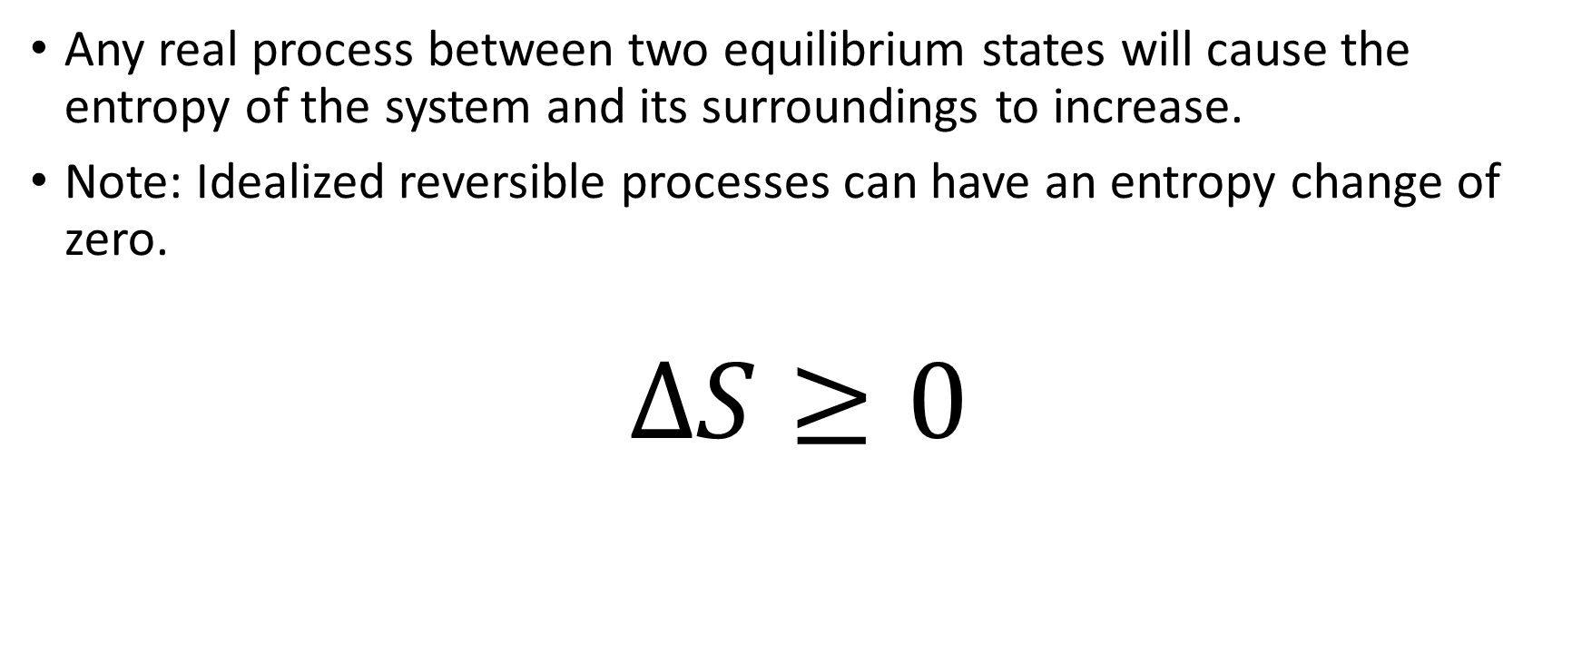
Second Law of Thermodynamics
Any real process between two equilibrium states will cause the entropy of the system and its surroundings to increase.
Note: Idealized reversible processes can have an entropy change of zero.
$$∆S≥0$$

Slide 50
Reversible processes and Work Done
If we want to extract the maximum work from a thermodynamic transition between states we want the process to be as close to reversible as possible.
Piston example. Isothermal (reversible) expansion contrasted with varying degrees of sudden expansion.

Slide 51
Carnot Cycle and the heat Engine
Cycle with 2 isothermal legs at T_{H} and T_{C} and two adiabatic legs connecting the isotherms.
Represent the process on a PV diagram
Heat is converted to work—what is the efficiency in terms of Q_{H}, Q_{C} and W?
Using a T versus S diagram show that Q_{H}/Q_{C}=T_{H}/T_{C}

Slide 52
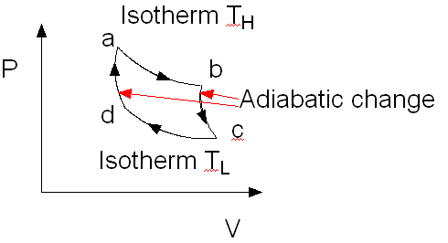
Carnot Cycle: Ideal Heat Engine

Slide 53
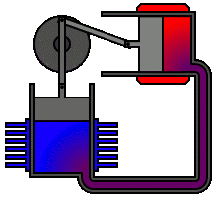
Stirling engine
http://www.youtube.com/watch?v=W9cK_TMLvjI

Slide 54
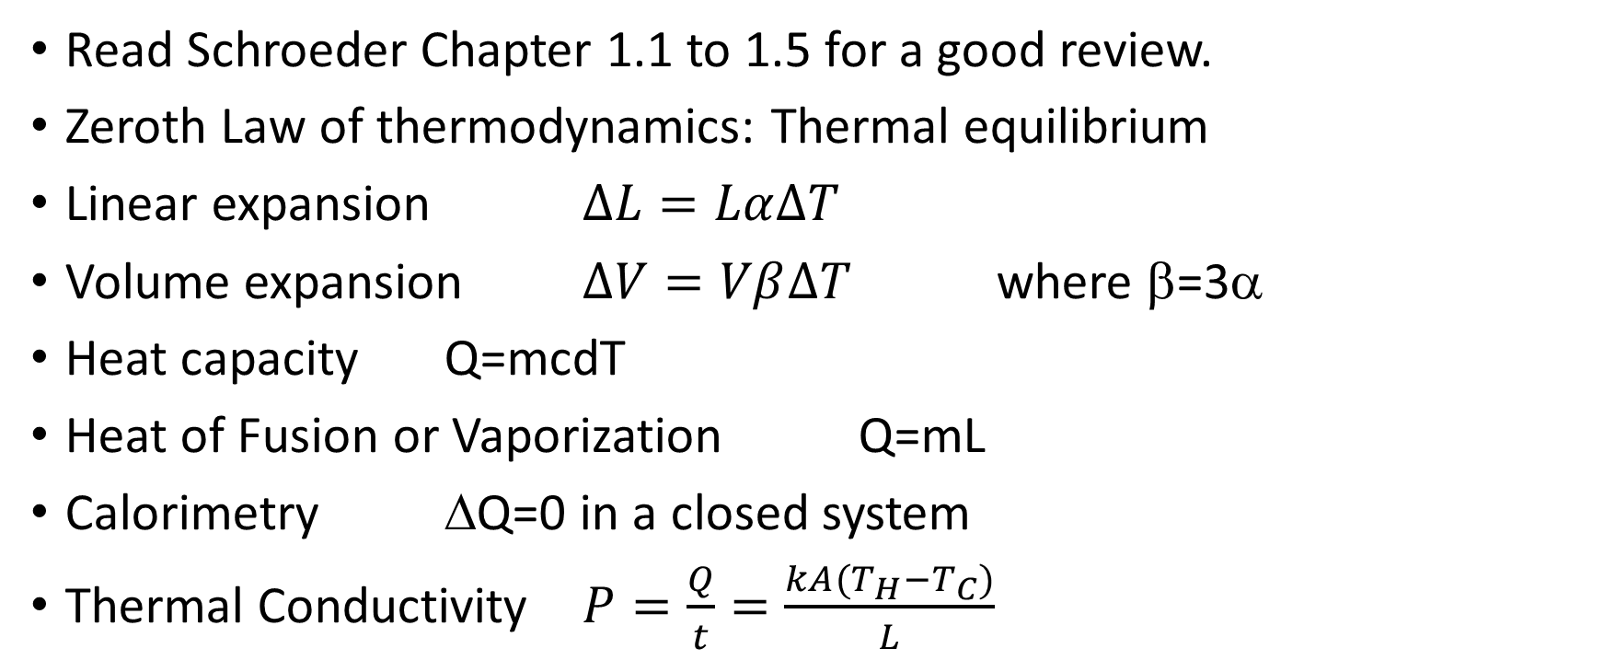
Summary: basic thermodynamics
Read Schroeder Chapter 1.1 to 1.5 for a good review.
Zeroth Law of thermodynamics: Thermal equilibrium
Linear expansion $∆L=Lα∆T$
Volume expansion $∆V=Vβ∆T$ where β=3α
Heat capacity Q=mcdT
Heat of Fusion or Vaporization Q=mL
Calorimetry ΔQ=0 in a closed system
Thermal Conductivity $P=\frac{Q}{t}=\frac{kA(T_{H}{−T}_{C})}{L}$

Slide 55
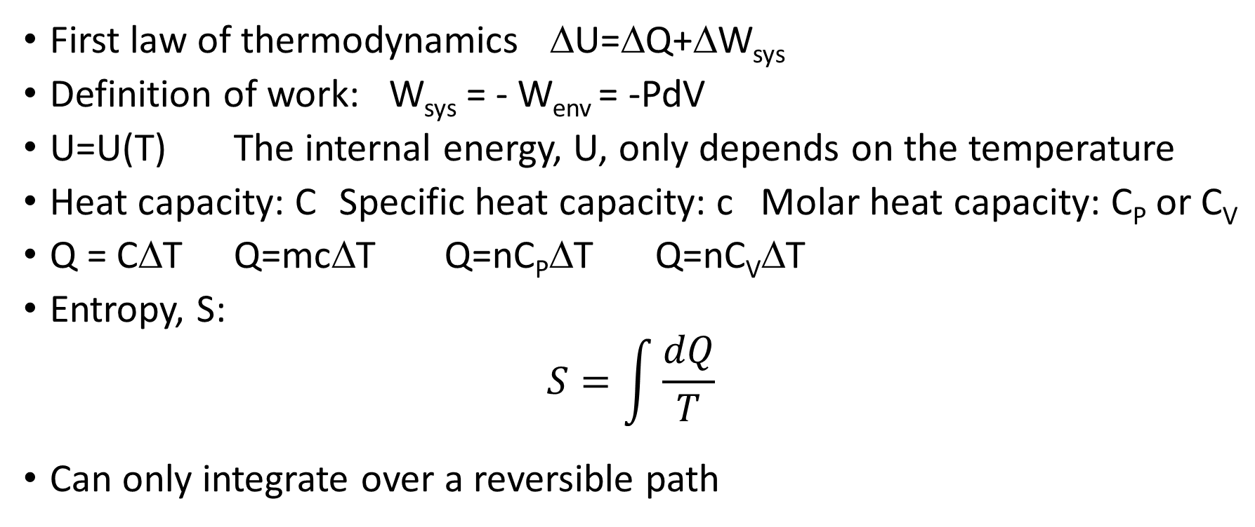
Summary: cont.
First law of thermodynamics ΔU=ΔQ+ΔW_{sys}
Definition of work: W_{sys} = - W_{env} = -PdV
U=U(T) The internal energy, U, only depends on the temperature
Heat capacity: C Specific heat capacity: c Molar heat capacity: C_{P} or C_{V}
Q = CΔT Q=mcΔT Q=nC_{P}ΔT Q=nC_{V}ΔT
Entropy, S:
$$S=\int{\frac{dQ}{T}}$$
Can only integrate over a reversible path

Slide 56
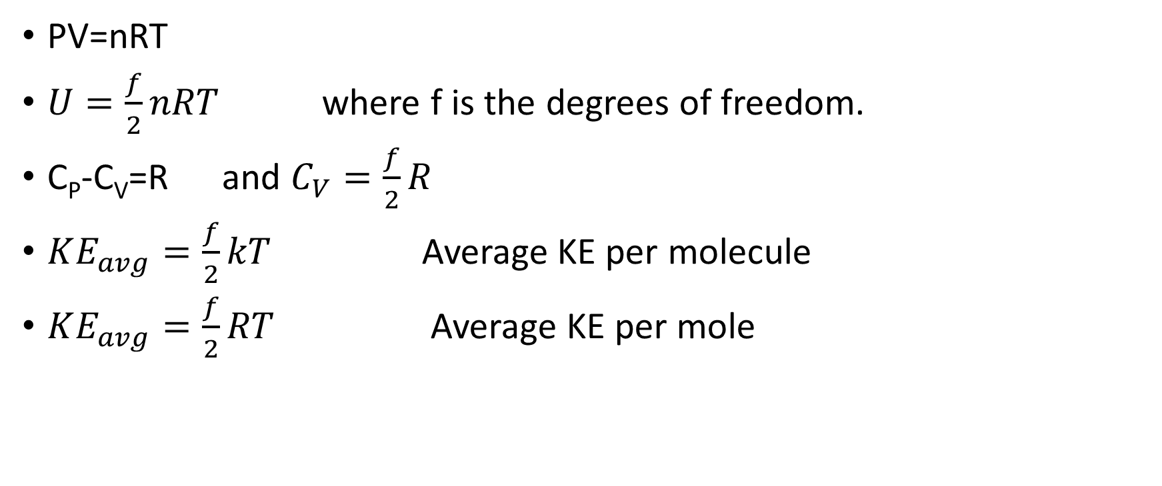
Ideal Gas
PV=nRT
$U=\frac{f}{2}nRT$ where f is the degrees of freedom.
C_{P}-C_{V}=R and $C_{V}=\frac{f}{2}R$
$KE_{avg}=\frac{f}{2}kT$ Average KE per molecule
$KE_{avg}=\frac{f}{2}RT$ Average KE per mole

Slide 57
Thermodynamic processes
Isothermal: Constant T and hence constant U. ΔU = 0 = ΔQ + ΔW
Adiabatic: no heat in or out ΔQ = 0 and PV^{γ}=constant
Isometric, isochoric, isovolumetric: Constant volume ΔW=0
Isobaric: Constant pressure

Slide 58
Reversible processes
Reversible cycle: ΔS_{cycle} = ΔU_{cycle} = 0
S is a state variable and the value of S will be fixed for a given state now matter how the state was arrived at.

Slide 59
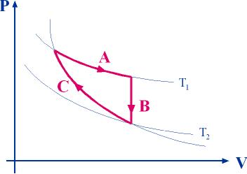
Example
A real gas is taken through the cycle shown at right. The two isotherms are at temperatures T₁ and T₂. Process A is isothermal, Process B is isometric, and Process C is adiabatic. When run in the direction shown, the cycle acts as a heat engine. Find an expression for the efficiency of this heat engine in terms of the given temperatures T₁ and T₂.

Slide 60
Example: Kinetic Theory of Gases
Five moles of helium is held in a closed container at a pressure of 1.5 atm at 293 K. [1 amu = 1.66 x 10⁻²⁷ kg, k=1.38 x 10⁻²³ J/K]
What is the volume of the container?
What is the RMS velocity of a helium atom in the gas?
If the gas is compressed adiabatically to one quarter its initial volume what are the final temperature and pressure of the gas?
If the same compression is done isothermally what are the final temperature and pressure of the gas?

Slide 61
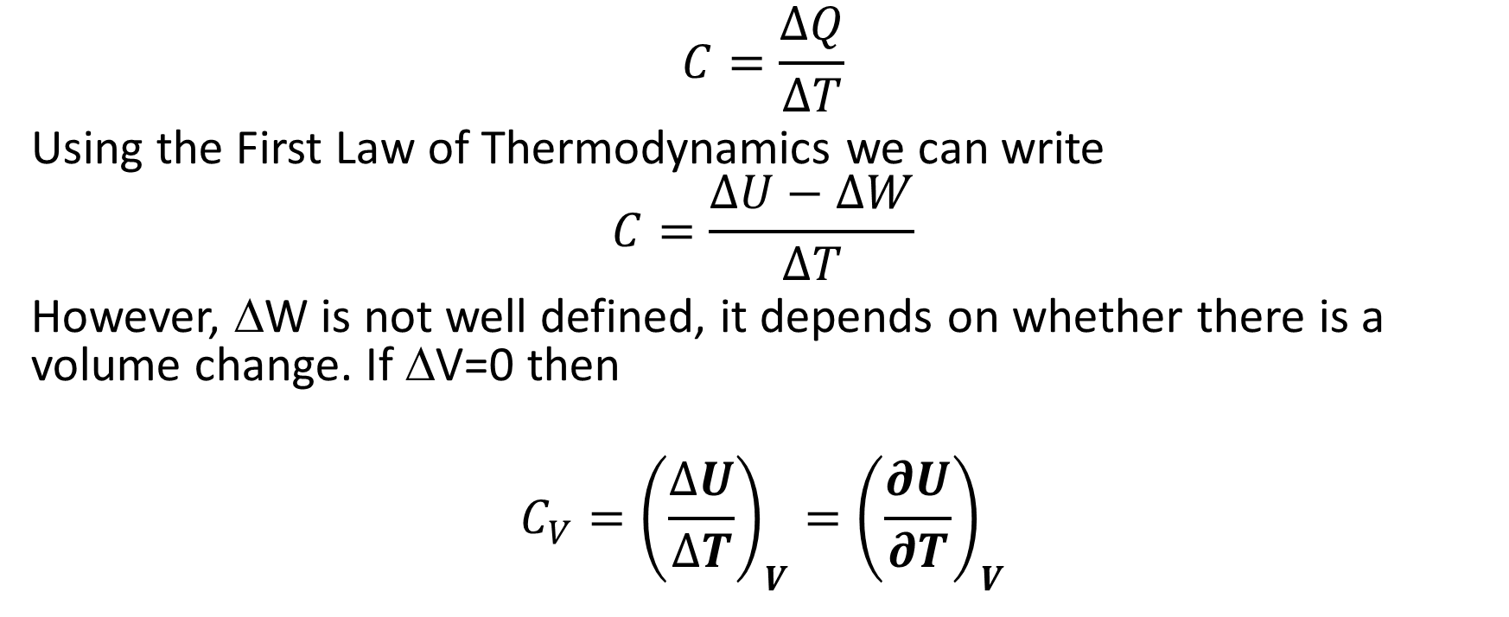
Heat Capacity Revisited
$$C=\frac{∆Q}{∆T}$$
Using the First Law of Thermodynamics we can write
$$C=\frac{∆U−∆W}{∆T}$$
However, ΔW is not well defined, it depends on whether there is a volume change. If ΔV=0 then
$$C_{V}={\left(\frac{∆U}{∆T}\right)}_{V}={\left(\frac{∂U}{∂T}\right)}_{V}$$

Slide 62
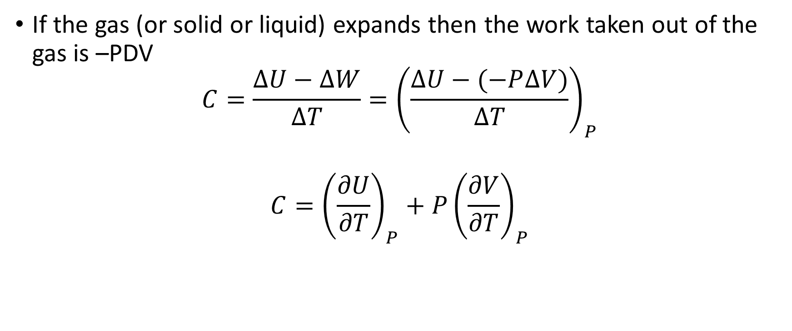
Heat Capacity constant pressure
If the gas (or solid or liquid) expands then the work taken out of the gas is –PDV
$$C=\frac{∆U−∆W}{∆T}={\left(\frac{∆U−(−P∆V)}{∆T}\right)}_{P}$$
$$C={\left(\frac{∂U}{∂T}\right)}_{P}+{P\left(\frac{∂V}{∂T}\right)}_{P}$$

Slide 63
New Heat Capacity relations
Test with kinetic theory/ideal gas
Solids—6 degrees of freedom => C_{V}=3R

Slide 64
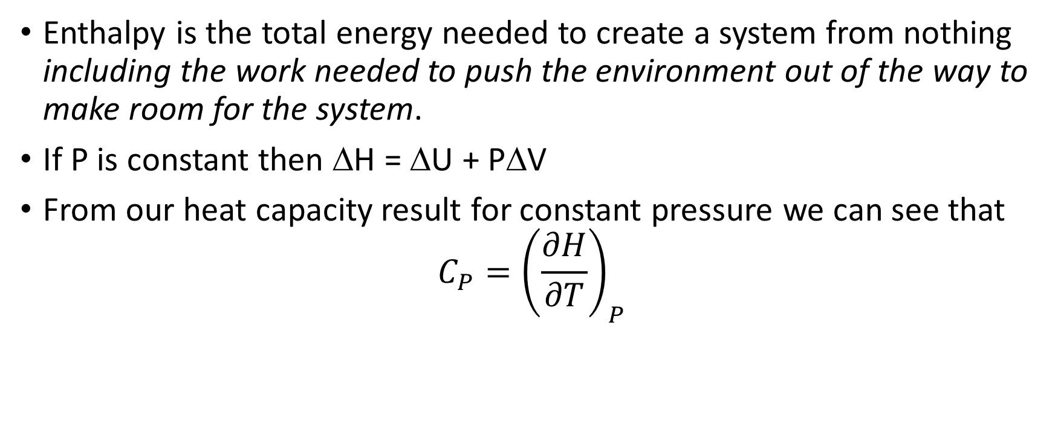
Enthalpy: H
Enthalpy is the total energy needed to create a system from nothing including the work needed to push the environment out of the way to make room for the system.
If P is constant then ΔH = ΔU + PΔV
From our heat capacity result for constant pressure we can see that
$$C_{P}={\left(\frac{∂H}{∂T}\right)}_{P}$$

Slide 65
Example
A 150 g copper bowl contains 220 g of water, both at 20.0 ºC. A very hot 300 g iron rod at 770 ºC is dropped into the water. Assume that the entire system is isolated from its environment.
Some Data:Specific Heats in J/(kg.K): Water: 4186, Copper: 385, Iron: 460Latent Heat of Vaporization for Water: 2272 kJ/kg
(a) What is the final temperature of the system?
(b) Describe the final condition of the system.

Slide 66
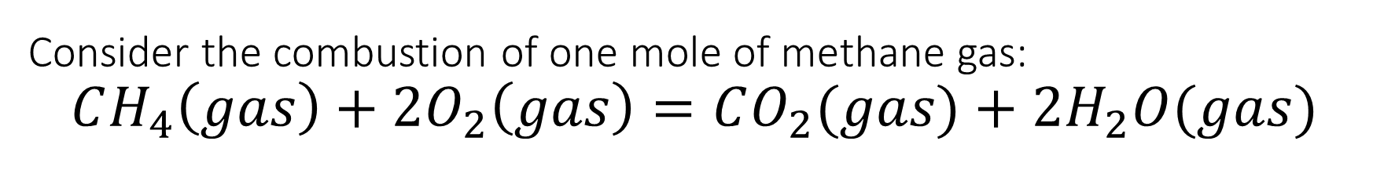
Consider the combustion of one mole of methane gas:
$$CH_{4}\left(gas\right)+2O_{2}\left(gas\right)=CO_{2}(gas)+2H_{2}O(gas)$$
The system is at standard temperature (298 K) and pressure (10⁵ Pa) both before and after the reaction.
(a) Calculate ΔH for breaking apart one mole of methane into graphite and hydrogen gas (its elemental constituents).
(b) Calculate ΔH for forming one mole of CO₂ and two moles of water vapor from their elemental constituents.
(c) What is ΔH for the actual reaction in which methane and oxygen combine to form carbon dioxide and water vapor directly?
(d) How much heat is given off during this reaction, assuming that no “other” forms of work are done?
(e) What is the change in the system’s internal energy during this reaction?
(f) How would your answer to (e) differ if the H₂O ended up as water instead of vapor?

Slide 67
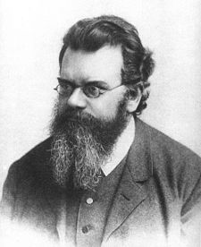
Statistical Mechanics
An approach to thermodynamics that examines all of the possible states of a system consisting of a very large number of constituents and uses probability and statistics to determine the most likely configuration.
The goal is to understand the macroscopic thermodynamic properties of a system in terms of the collective microscopic behavior of the systems constituents.

Slide 68
Microstates and Macrostates
Consider the example of the possible states (H or T) of 3 coins.
The coins are distinguishable: quarter, nickel, dime
List all the possible configurations.
Each separate configuration in which the coin and its state are specified is a microstate of the system
If I ask for states that have 2 H and 1 T there are many microstates of this kind. The group of states that satisfy this condition is a macrostate. The number of microstates that satisfy this macrostate is called the multiplicity of the macrostate.

Slide 69
Microstates & Macrostates
Quarter | Nickel | Dime
H | H | H
H | H | T
H | T | H
T | H | H
H | T | T
T | H | T
T | T | H
T | T | T

Slide 70
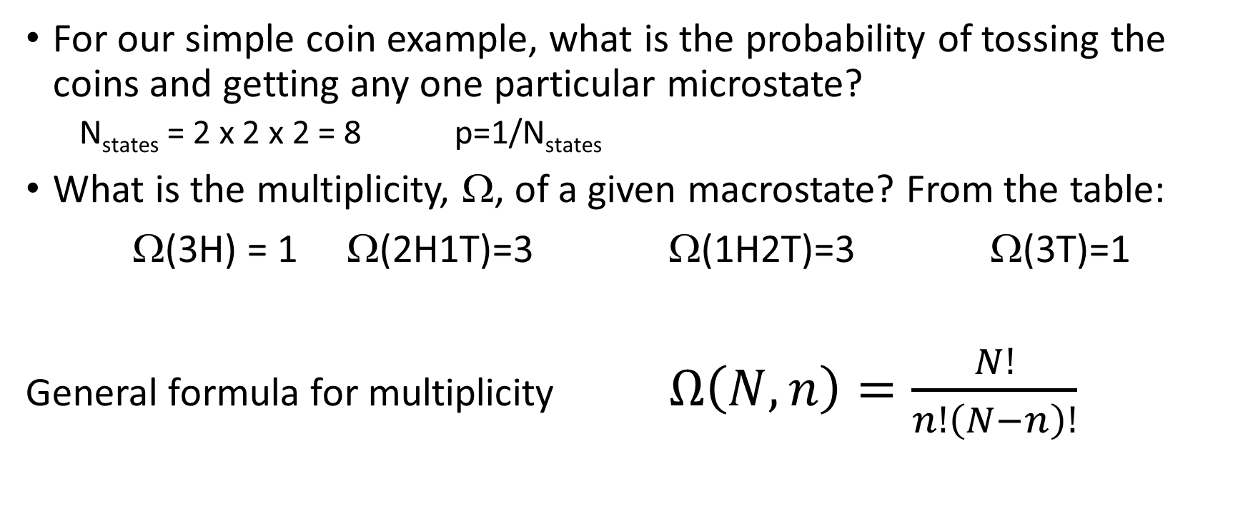
Probability of any particular coin arrangement
For our simple coin example, what is the probability of tossing the coins and getting any one particular microstate?
  N_{states} = 2 x 2 x 2 = 8 p=1/N_{states}
What is the multiplicity, Ω, of a given macrostate? From the table:
Ω(3H) = 1 Ω(2H1T)=3 Ω(1H2T)=3 Ω(3T)=1
General formula for multiplicity $Ω\left(N,n\right)=\frac{N!}{n!\left(N−n\right)!}$

Slide 71
20 coin example
How many microstates are there?
What is the probability of any one specific microstate, say HHHHTTTTHHHHTTTTHHHH in that order?
Is the probability of the previous sequence more or less likely than getting 20 heads.
What is the probability of getting a macrostate with 12 H and 8 T?
What is the probability of getting a macrostate with 3 H and 17 T?
What would a bar graph of Ω versus every combo from 20 H to 20 T look like?

Slide 72
100 coins on a tray example
Imagine 100 coins all with Heads face up on a tray. I whack the tray and a few coins flip from heads to tails. If I whack it again is it likely to return to its ordered 100 head state or become more disordered?
Entropy is often referred to as a measure of the disorder of a system. Will entropy increase in my whacked tray example?

Slide 73
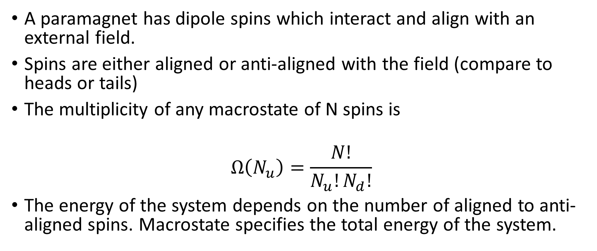
A physical model: paramagnet
A paramagnet has dipole spins which interact and align with an external field.
Spins are either aligned or anti-aligned with the field (compare to heads or tails)
The multiplicity of any macrostate of N spins is
$$Ω\left(N_{u}\right)=\frac{N!}{N_{u}!N_{d}!}$$
The energy of the system depends on the number of aligned to anti-aligned spins. Macrostate specifies the total energy of the system.

Slide 74
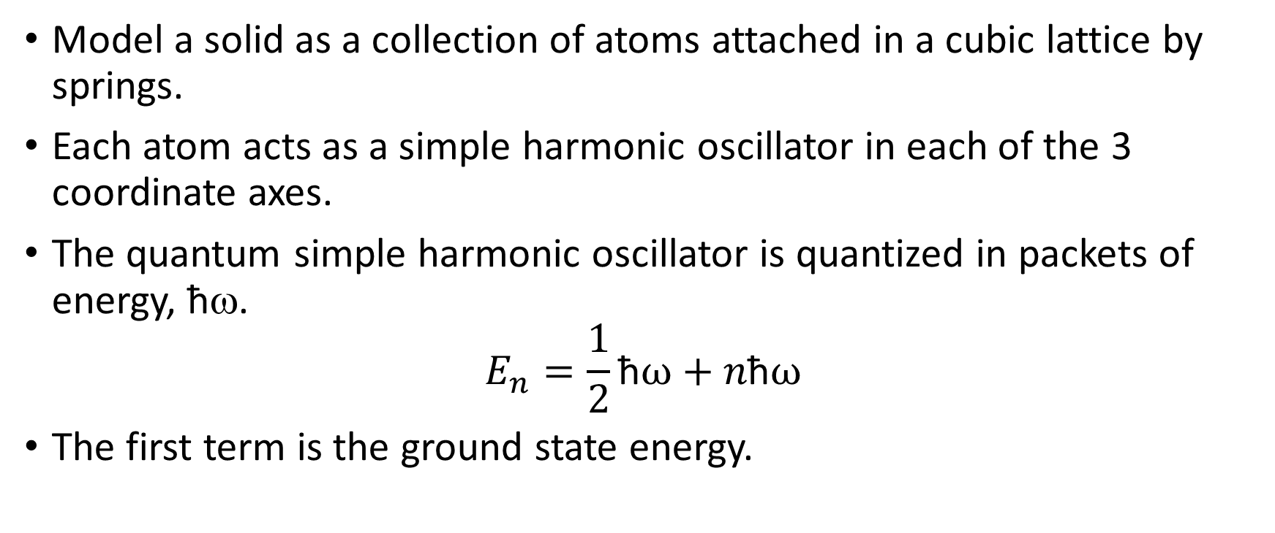
Einstein model of a solid
Model a solid as a collection of atoms attached in a cubic lattice by springs.
Each atom acts as a simple harmonic oscillator in each of the 3 coordinate axes.
The quantum simple harmonic oscillator is quantized in packets of energy, ħω.
$$E_{n}=\frac{1}{2}\text{ħ}ω+n\text{ħ}ω$$
The first term is the ground state energy.

Slide 75
Einstein Model of a solid
List the microstates of one atom with 0, 1, 2, and 3 units of total excitation energy (1 unit = ħω)—i.e. energy in excess of the ½ ħω
Note: 1 atom means 3 oscillators

Slide 76
Formula to determine the multiplicity in an Einstein Solid
Dots and lines.
Dots represent energy quanta, (q = total number) lines separate one oscillator from the next (N= total number of oscillators).
What is N and q here?
What state does this represent from our previous example?
Derive the multiplicity formula for this system.

Slide 77
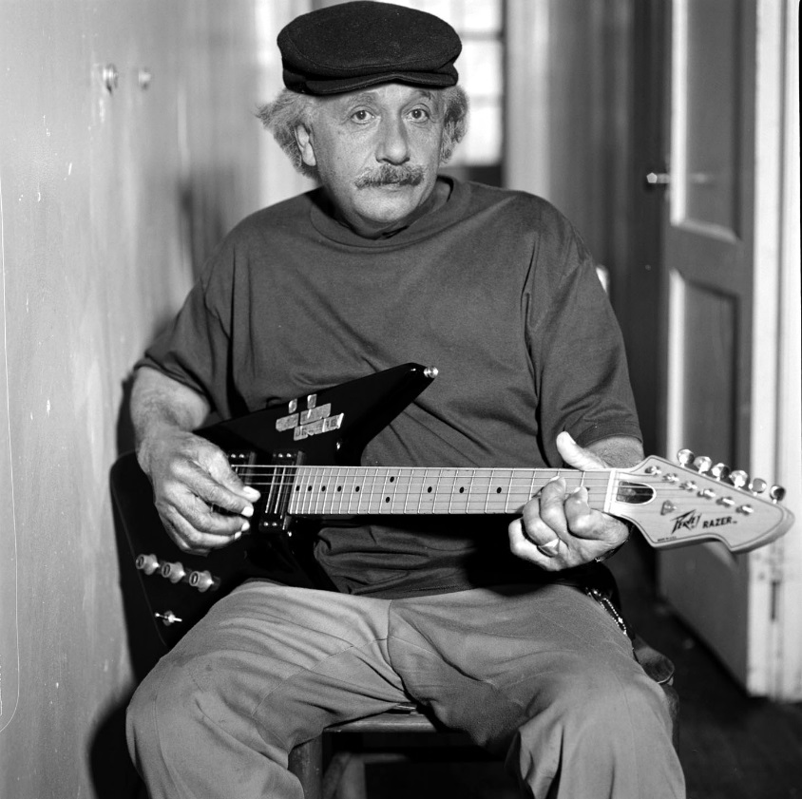
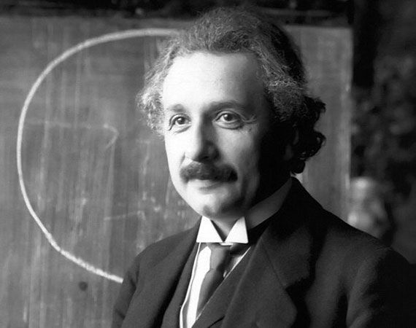

The Einstein Solid Multiplicity Formula
$$Ω\left(N,q\right)=\frac{\left(q+N−1\right)!}{q!\left(N−1\right)!}$$

Slide 78
Interacting Einstein Solids
Consider an isolated system of two interacting Einstein solids, A and B. The number of oscillators in A is 3, and the number in B is 2; the total excitation energy quantum number for the entire system is 5. We shall concern ourselves in this example with the energy macrostate corresponding to q_{A} = 2 (and therefore q_{B} = q_{total} – q_{A} = 3).
Make a table showing all possible microstates in A corresponding to the macrostate q_{A} = 2. What is the multiplicity of this macrostate in A, Ω_{A}?
(b) Make a table showing all possible microstates in B corresponding to the
macrostate q_{A} = 2. What is the multiplicity of this macrostate in B, Ω_{B}?
(c) What is the total multiplicity of this macrostate for the entire system, Ω?
(d) List all possible macrostates for this system, along with the total multiplicity of
each macrostate.
(e) Construct a plot of multiplicity vs. macrostate for this system of 5 oscillators.

Slide 80
Fundamental postulate of statistical mechanics
Given an isolated system in equilibrium, the system has equal probability of being in each of its accessible microstates.

Slide 81
23 oscillators (10 in A, 13 in B) 25 energy quanta

Slide 82
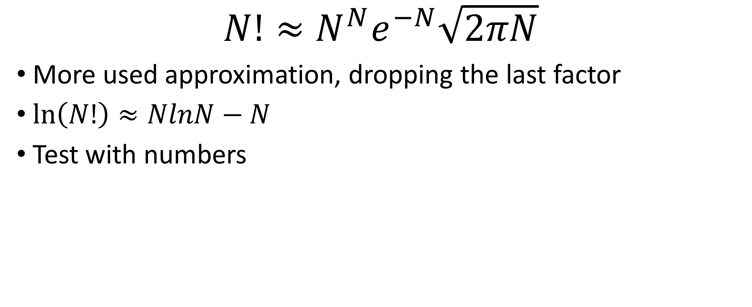
Stirling’s Approximation
$$N!≈N^{N}e^{−N}\sqrt{2πN}$$
More used approximation, dropping the last factor
$\ln\left(N!\right)≈NlnN−N$
Test with numbers

Slide 83
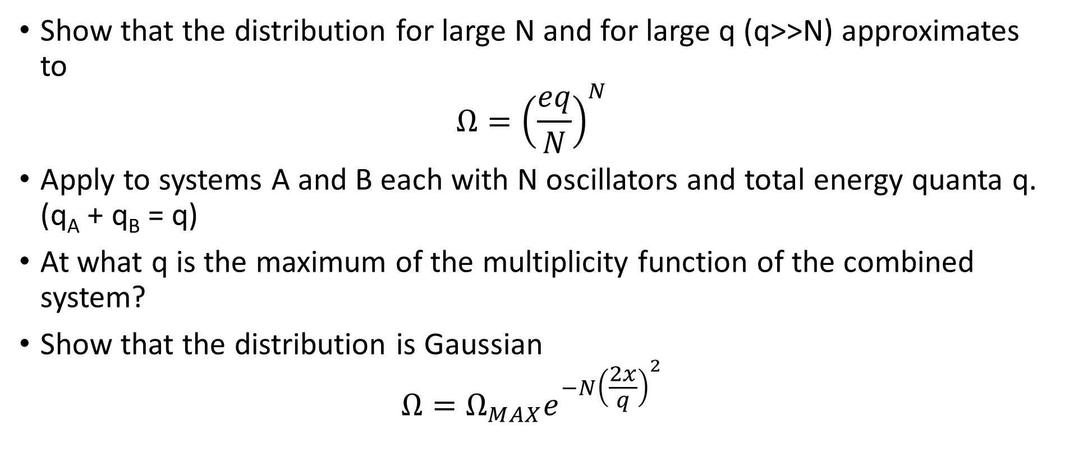
Stirling’s Approximation applied to Einstein Solid
Show that the distribution for large N and for large q (q>>N) approximates to
$$Ω={\left(\frac{eq}{N}\right)}^{N}$$
Apply to systems A and B each with N oscillators and total energy quanta q. (q_{A} + q_{B} = q)
At what q is the maximum of the multiplicity function of the combined system?
Show that the distribution is Gaussian
$$Ω=Ω_{MAX}e^{{−N\left(\frac{2x}{q}\right)}^{2}}$$

Slide 84
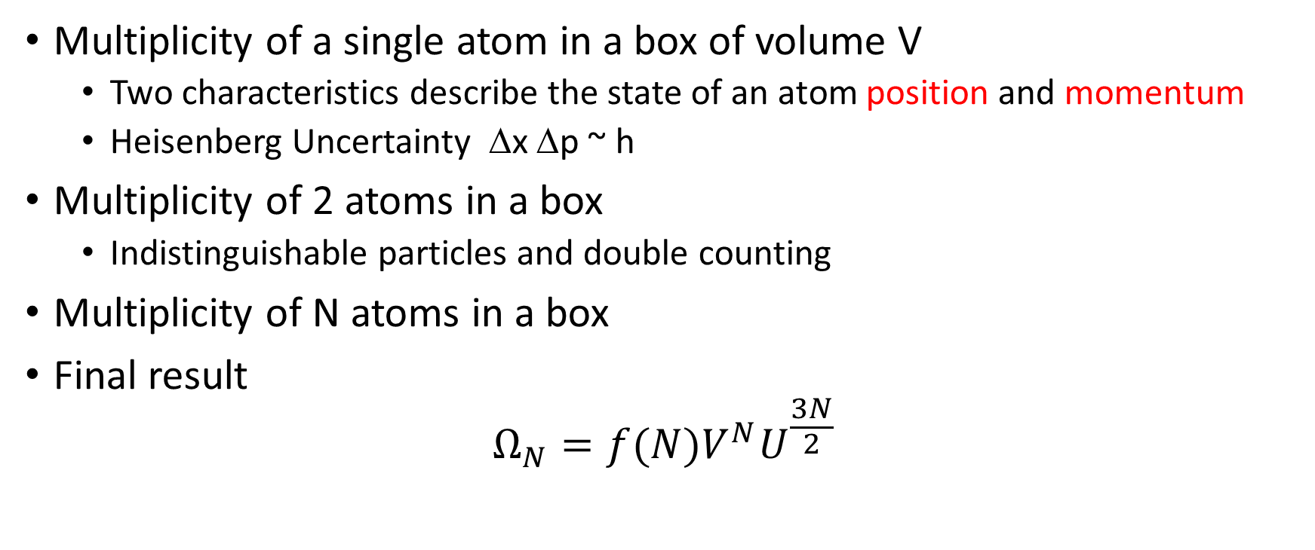
Multiplicity of an Ideal Gas
Multiplicity of a single atom in a box of volume V
  Two characteristics describe the state of an atom position and momentum
  Heisenberg Uncertainty Δx Δp ~ h
Multiplicity of 2 atoms in a box
  Indistinguishable particles and double counting
Multiplicity of N atoms in a box
Final result
$$Ω_{N}=f(N)V^{N}U^{\frac{3N}{2}}$$

Slide 85
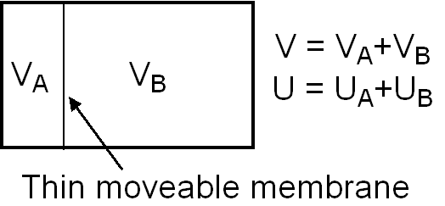
Apply to an interacting gas
Two volumes of gas V_{A} and V_{B} each with N atoms are in an isolated container separated by a thin membrane that can move. They contain a total internal energy U. They can interact by exchanging energy (but not atoms) through the membrane. What is the equilibrium position of the membrane? What is the equilibrium internal energy of each gas?

Slide 86
Basic ideas from multiplicity
The equilibrium state of any interacting system is in a narrow range close to the state in which the multiplicity Ω_{total} is a maximum.
Any large system in equilibrium will be found in the macrostate with the greatest multiplicity. Large numbers means that the fluctuations from Ω_{max} are almost immeasurable.
The statement “multiplicity tends to increase” is essentially a statement of the second law of thermodynamics ΔS ≥ 0.

Slide 87
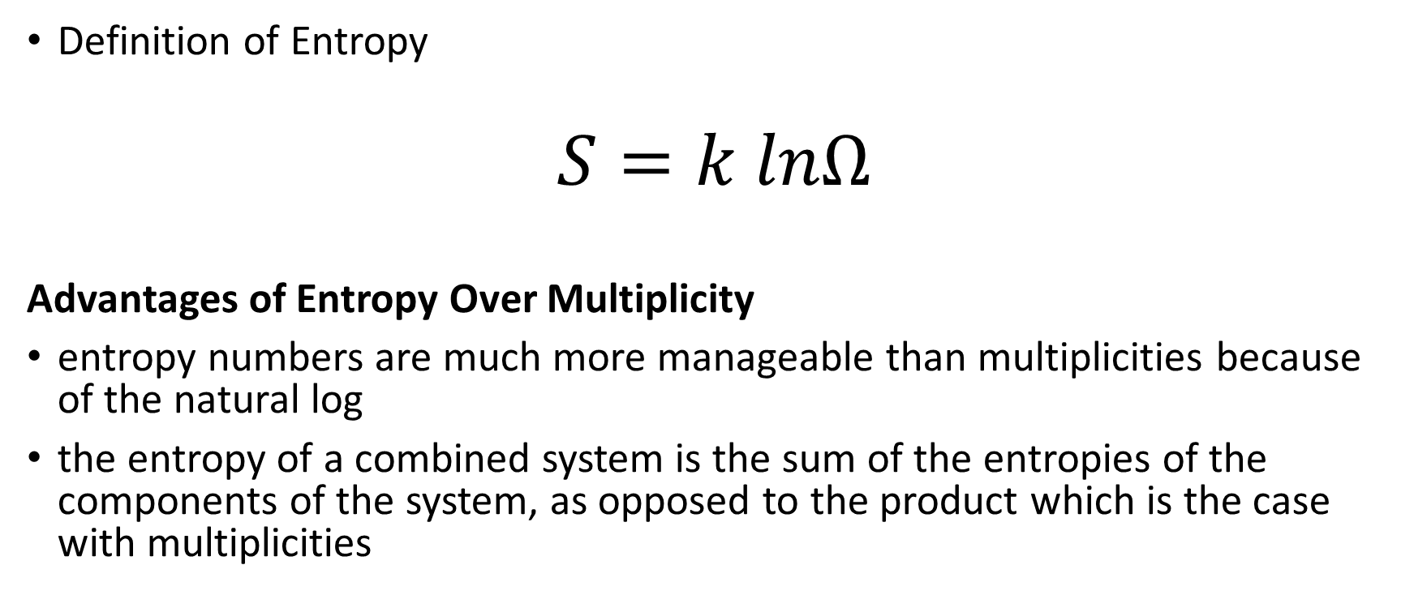
Relating Ω to S: Definition of Entropy
Definition of Entropy
$$S=k lnΩ$$
Advantages of Entropy Over Multiplicity
entropy numbers are much more manageable than multiplicities because of the natural log
the entropy of a combined system is the sum of the entropies of the components of the system, as opposed to the product which is the case with multiplicities

Slide 88
Second Law in terms of Entropy
The Second Law of Thermodynamics in Terms of Entropy
Statement A: The entropy of a combined system always increases as it approaches thermodynamic equilibrium.
Statement B: A system in thermodynamic equilibrium must be in a state of maximum entropy.

Slide 89
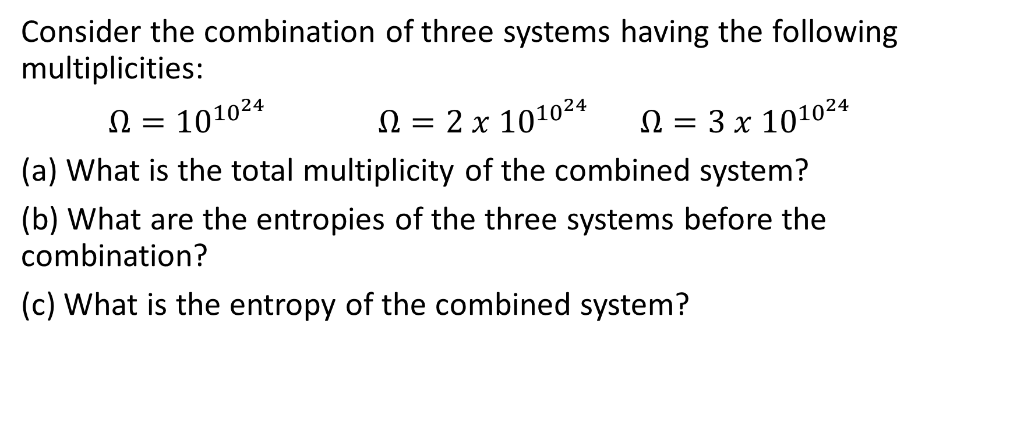
Example
Consider the combination of three systems having the following multiplicities:
$Ω={10}^{{10}^{24}}$ $Ω={2 x 10}^{{10}^{24}}$ $Ω={3 x 10}^{{10}^{24}}$
(a) What is the total multiplicity of the combined system?
(b) What are the entropies of the three systems before the combination?
(c) What is the entropy of the combined system?

Slide 90
Example
Apply the entropy formula to an Einstein solid with N oscillators and q>>N energy quanta.
Calculate S for the case N=10²³ q=10²⁵.

Slide 91
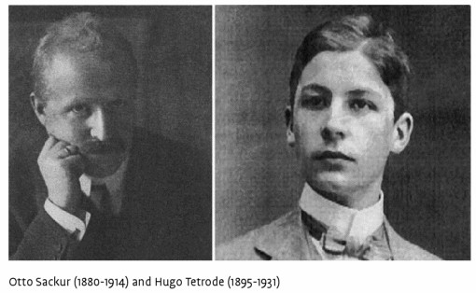
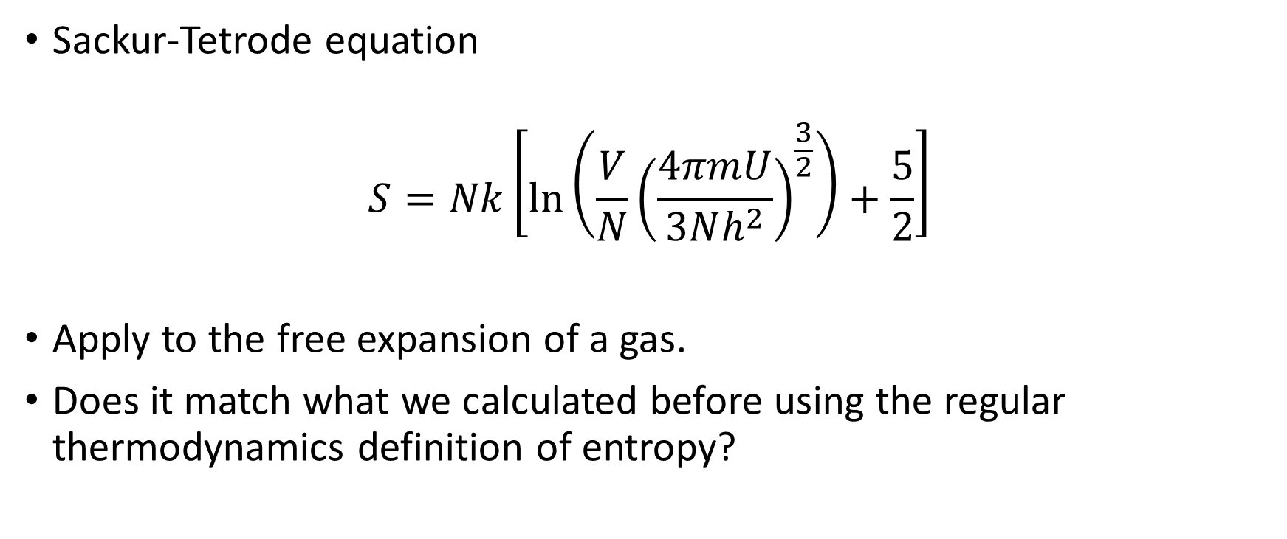
Sackur-Tetrode Equation
Sackur-Tetrode equation
$$S=Nk\left[\ln\left(\frac{V}{N}{\left(\frac{4πmU}{3Nh^{2}}\right)}^{\frac{3}{2}}\right)+\frac{5}{2}\right]$$
Apply to the free expansion of a gas.
Does it match what we calculated before using the regular thermodynamics definition of entropy?

Slide 92
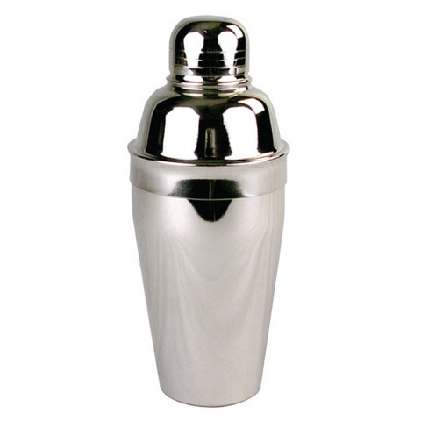
Entropy of mixing
Compare the change in entropy caused by allowing 2 different gases A and B with equal energy, initial volume, and number of particles to mix by removing a partition separating them. Each gas mixes so that it occupies twice its original volume. What is the change in entropy? This increase is the entropy of mixing.
Is the entropy change the same if the two gases are the same?

Slide 93
Distinguishable and indistinguishable particles
Now consider a volume V with a mole of He. If I add a mole of Ar what is the entropy change?
If instead I add another mole of He. What is the change in entropy?

Slide 94
Reversible versus Irreversible (again)
Any process that increases entropy must be irreversible.
Sudden compressions are irreversible—they increase the multiplicity.
Heat flow is generally irreversible. Reversible only for 2 objects very close in temperature.
Heat flow in the context of interacting Einstein solids—temperature, energy density, and probability.
Heat death of the universe and the flow of time…
Entropy at the beginning of time was very low—how?

Slide 95
Entropy and Temperature
Our aim is to define temperature in terms of entropy.
Consider two definitions of thermal equilibrium:
  Thermal equilibrium between two systems is when their combined total entropy has reached its maximum value. (Second Law of Thermodynamics)
  Thermal equilibrium between two objects means that their temperatures are the same.
Use the example of an Einstein solid with 300 oscillators in A and 200 in B sharing 100 quanta of energy. (N_{A}=300, N_{B}=200, q_{total}=100).

Slide 96
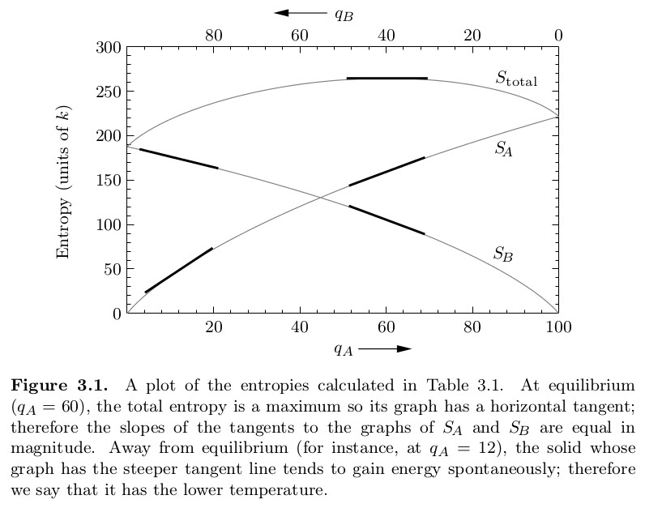

Slide 97
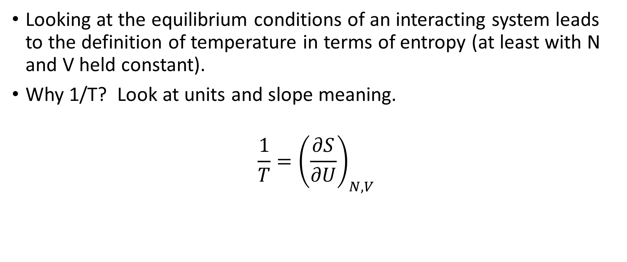
Entropy and temperature
Looking at the equilibrium conditions of an interacting system leads to the definition of temperature in terms of entropy (at least with N and V held constant).
Why 1/T? Look at units and slope meaning.
$$\frac{1}{T}={\left(\frac{∂S}{∂U}\right)}_{N,V}$$

Slide 98
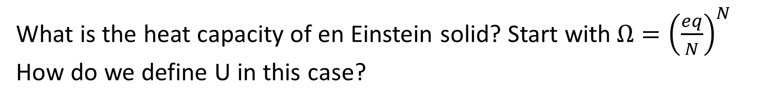

Heat Capacity Reminder (at constant V)
$$C_{V}={\left(\frac{∂U}{∂T}\right)}_{N,V}$$
What is the heat capacity of en Einstein solid? Start with$Ω={\left(\frac{eq}{N}\right)}^{N}$
How do we define U in this case?

Slide 99
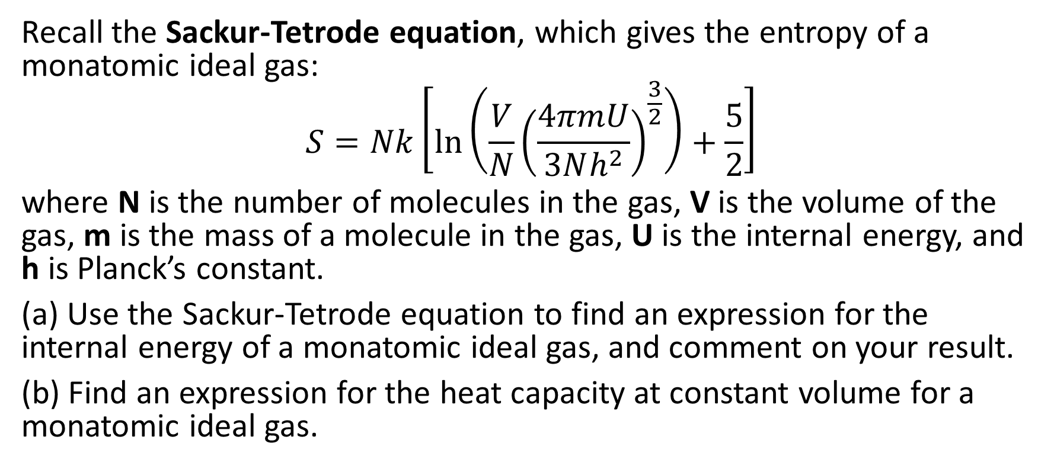
Example
Recall the Sackur-Tetrode equation, which gives the entropy of a monatomic ideal gas:
$$S=Nk\left[\ln\left(\frac{V}{N}{\left(\frac{4πmU}{3Nh^{2}}\right)}^{\frac{3}{2}}\right)+\frac{5}{2}\right]$$
where N is the number of molecules in the gas, V is the volume of the gas, m is the mass of a molecule in the gas, U is the internal energy, and h is Planck’s constant.
(a) Use the Sackur-Tetrode equation to find an expression for the internal energy of a monatomic ideal gas, and comment on your result.
(b) Find an expression for the heat capacity at constant volume for a monatomic ideal gas.

Slide 100
Example
A 120 g ice cube is removed from freezer at –15ºC and dropped on the floor.
(a) Estimate the change in entropy of the ice from when it was removed from the freezer until some time later when a small puddle is found on the floor.
(b) What was the change in entropy of the room during this process?
(c) What was the total change in entropy for the system (the ice) and its environment?
(d) You should have found in the previous part that the entropy of the system plus its environment increased as thermodynamic equilibrium was reached, as required by the second law. Nevertheless, the overall change in entropy may seem rather small. Compute the corresponding factor by which the multiplicity of the system and its environment increased during this process.
(e) The solution to the problems above exploited the equation for ΔS in terms of heat flow, Q. But this equation assumes that N and V are both constant. Is this a reasonable assumption in this case?
Data: c_{ice} = 2090 J/kgK c_{water} = 4184 J/kgK L_{f} = 334 kJ/kg

Slide 101
Entropy and Energy Content
In general as we increase the energy of a system we increase the number of available states. More states means increased multiplicity and thus increased entropy.
For example, if we put more energy into an Einstein solid we are increasing q and we know that increases Ω.
Next we examine a simple system – the paramagnet – that exhibits a reducing multiplicity (entropy) with increasing energy. This behavior leads to the concept of negative absolute temperature.

Slide 102
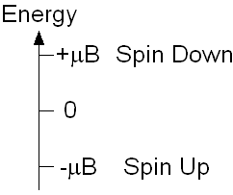
Paramagnetism
A simple system with N total spin ½-particles in a magnetic field B.
N_{U} is the number of spin up particles (magnetic moment μ aligned with B) and N_{D} is the number of spin down (magnetic moment μ opposite to the direction of B).
Dipole aligned with B field is the stable low energy state. To flip to be antiparallel requires energy 2μB.
Internal energy U = μB (N_{D}-N_{U}) = μB (N-2N_{U})
Magnetization M = μ(N_{U}-N_{D}) = - U/B

Slide 103
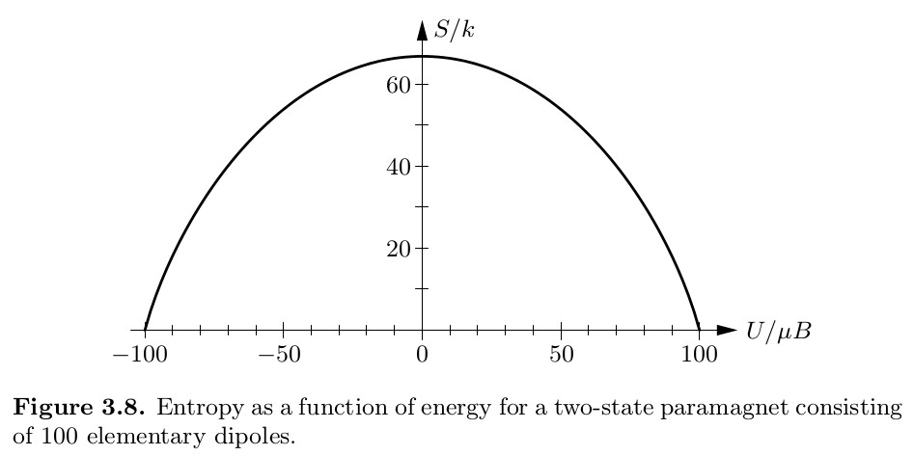

Multiplicity of a paramagnet
$$Ω=\frac{N!}{N_{U}{!N}_{D}!}$$

Slide 104
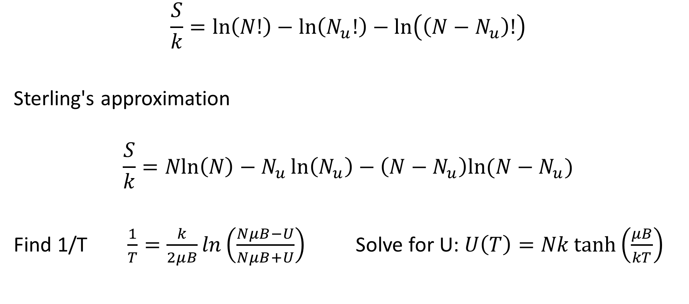
Entropy of a paramagnet
$$\frac{S}{k}=\ln\left(N!\right)−\ln\left(N_{u}!\right)−\ln\left(\left(N−N_{u}\right)!\right)$$
Sterling's approximation
$$\frac{S}{k}=Nln\left(N\right)−N_{u}\ln\left(N_{u}\right)−\left(N−N_{u}\right)ln⁡(N−N_{u})$$
Find 1/T $\frac{1}{T}=\frac{k}{2μB}ln\left(\frac{NμB−U}{NμB+U}\right)$ Solve for U: $U\left(T\right)=Nk\tanh\left(\frac{μB}{kT}\right)$

Slide 105


Energy versus Temperature
Find 1/T $\frac{1}{T}=\frac{k}{2μB}ln\left(\frac{NμB−U}{NμB+U}\right)$
Solve for U: $U\left(T\right)=Nk\tanh\left(\frac{μB}{kT}\right)$

Slide 106
Negative Absolute Temperature
From Modern Physics?
Population inversion and laser action.

Slide 107


Heat Capacity of a Paramagnet
Differentiate U with respect to T holding N and B constant.
$$C_{B}={\left(\frac{∂U(T)}{∂T}\right)}_{N,B}=Nk\frac{{\left( \frac{μB}{kT}\right)}^{2} }{\cosh^{2}\left(\frac{μB}{kT}\right)}$$

Slide 108

Curie’s Law
Use the condition μB/kT << 1 to determine the behavior of magnetization with temperature.
$$M\left(T\right)=μN tanh\left(\frac{μB}{kT}\right)$$

Slide 109
Entropy & Mechanical Equilibrium
Goal: Relate Pressure to Entropy
Consider volume exchange in 2 systems separated by a moveable partition.
Isolated such that U_{total} and V_{total} are fixed
Maximize entropy in U_{A} and V_{A}
Units

Slide 110

The Thermodynamic Identity
Imagine a process in which we change U by a small amount and V by a small amount. Write an expression for the change in entropy in terms of dU and dV.
Final result:
$$dU=TdS−PdV$$

Slide 111

Compare the Thermodynamic Identity to the First law of Thermodynamics
$$dU=TdS−PdV$$
$$dU = dQ + dW$$
By comparing these equations can we set dQ=TdS?
3 criteria: quasi-static (P changes uniformly), no non-mechanical work (chemical, electrical), no change in the number of particles.
If these criteria are satisfied then dQ=TdS is true, even if work is done.
If P is quasi-static and the process is adiabatic (dQ=0) then dS=0 and the process is isentropic (our new word for the day).

Slide 112
Example
Thor brings down his hammer on a 100 cm² piston that moves freely in a 1 m long cylinder. His mighty blow has a force of 50 atm but the piston only moves 2 mm before it hits the rods of Woden (actually, just wooden rods) which stops the piston in its tracks.
What is the change in internal energy of the gas in the piston? (Assume all Thor’s work went into the gas)
What is the change of entropy of the gas?

Slide 113

Diffusive Equilibrium and Chemical Potential
Goal: Relate particle number N to entropy.
Consider the system with a perforated barrier that allows particle exchange. U_{total} and N_{total} are fixed.
Same approach as for Pressure/Volume
End results: Chemical potential, μ:
$$μ=−T{\left(\frac{∂S}{∂N}\right)}_{U,V}$$

Slide 114

Generalized Thermodynamic Identity
Chemical potential μ, equivalent to Fermi level in solid state physics.
μ indicates the direction in which particles will migrate.
The units of μ are Joules.
Particles migrate from higher to lower chemical potential.
μ is to particle diffusion as temperature is to energy flow.
Generalized Thermodynamic Identity:
$dU=TdS−PdV+μdN$
Calculate μ for an Ideal Gas using Sackur-Tetrode.

Slide 115

Summary
Interaction Type | Quantity Exchanged | Variable | Equation
Thermal | energy | temperature | $$\frac{1}{T}={\left(\frac{∂S}{∂U}\right)}_{V,N}$$
Mechanical | volume | pressure | $$\frac{P}{T}={\left(\frac{∂S}{∂V}\right)}_{U,N}$$
Diffusive | particles | chemical potential | $$\frac{μ}{T}={−T\left(\frac{∂S}{∂N}\right)}_{U,V}$$

Slide 116
Information Theory
Claude Shannon (1948) – quantitative study of information.
Postulates
  A signal consists of a series of messages each conveying information from a source. The information is unknown before its arrival.
  Each message need not contain the same amount of information.
  The information content can be measured by the degree of uncertainty which is removed upon the arrival of the message.

Slide 117
Additive not Multiplicative scale
We want a measure of information that is additive. As each message of a signal arrives it should carry a certain amount of information that adds to the previous information.
Information is related to probability—but probabilities combine multiplicatively. How can we change multiplication to addition? Log scale.

Slide 118
Information content of a message
Information content in a message: Equivalent to the entropy of the message. I is often called the Shannon Entropy.
Note log to the base 2. Why? Because information age is binary i.e. a two level system.
Why the negative?

Slide 119
How do I find log₂(y)
Remember the definition of a log. In the equation below x is log₂ (y).
Take log10 of both sides

Slide 120
Info content of a signal
We defined the information content of a single message. The info content of a message is the average information content for a large number of messages that make up a typical signal. For a signal with n possible messages the average info per message is

Slide 121
Example
Letters of the alphabet (26 of them). Assume they occur with equal probability in a message p_{i}=1/26
Average information content per message is

Slide 122
Compression Example
ABAAAABAAAAABABAAAAAAAABABAAAA
0 1 0000 100000 1 01 0000000001 01 0000 30 digits
10 0 0110 0 0110110 0 0 0 10 10 0 0 24 digits
101 0 110 0 11101 0 0 100 101 0 22 digits
Code 1: The obvious code A=0 B=1.
Symbol Probability Representation # Digits
A 0.8 0 0.8
B 0.2 1 0.2
1.0
Conclusion: 1 digit per letter (i.e. message).

Slide 123
Other encoding schemes
Code 2: Group pairs of letters
Symbols Prob. Representation #digits
AA 0.64 0 0.64
AB 0.16 10 0.32
BA 0.16 110 0.48
BB 0.04 111 0.12
1.56
1.56 digits for 2 bits i.e. 0.78 digits per letter.

Slide 124
Yet another coding scheme
Code 3: group in 3’s.
Symbols Prob. Representation #digits
AAA 0.512 0 0.512
AAB 0.128 100 0.384
ABA 0.128 101 0.384
BAA 0.128 110 0.384
ABB 0.032 11100 0.160
BAB 0.032 11101 0.160
BBA 0.032 11110 0.160
BBB 0.008 11111 0.040
2.184
2.184 digits for 3 bits, i.e. 0.728 digits per letter

Slide 125

Heat Engines & Efficiency
A heat engine is any device that is capable of converting thermal energy (heat) into mechanical energy (work).
We want to investigate the limits that thermodynamics imposes on the efficiency of heat engines.
In the first part of the course we considered the maximum efficiency of a heat engine and showed it to be
  $e=1−\frac{T_{c}}{T_{H}}$

Slide 126
Can we convert 100% heat to work?
Consider the isothermal expansion of a fixed volume of an ideal gas.
As the gas expands does the internal energy of the gas change?
How the heat input relate to the work done?
Does this violate our Carnot limit?
Why is this not an engine?

Slide 127

An engine must be cyclic
The working substance must return to its original state so that the cycle can start again.
Original state: energy and entropy must return to their original values.
Q_{H}=Q_{C}+W
S_{in}+S_{out}=0
Total entropy of the system and surroundings must increase thus…
$$\frac{Q_{C}}{T_{C}}≥\frac{Q_{H}}{T_{H}}$$

Slide 128

Engine efficiency and refrigerator COP*
In each case use the relation:
e or COP = benefit/cost
For an engine the benefit is the work extracted W and the cost is the heat energy input Q_{H}
For a refrigerator the benefit is the heat extracted Q_{C} and the cost is the work done W
Thus,
$$e=\frac{W}{Q_{H}}$$
$$COP=\frac{Q_{C}}{W}$$
*COP=Coefficient of Performance

Slide 129
Ideal gas engine example
Consider a heat engine that uses an ideal gas as the working substance. The reversible cycle is shown in the figure and involves heat absorption 1-2 and heat exhaust 3-4 at constant pressures. The constant pressure levels are transitioned by adiabatic expansion and compression.
At which point (1, 2, 3, 4) is the temperature the highest?
Find the efficiency of the engine cycle in terms of P_{high} and P_{low}
Show that this is less efficient than a Carnot cycle.

Slide 130
Refrigerator
Definition of COP
A Carnot cycle of efficiency e=0.3 is run in reverse as a refrigerator. What is the corresponding COP? How much heat is extracted in 1 cycle if the work input is 7 kJ in one cycle?

Slide 131

Otto cycle: gas internal combustion engine
Heat is injected at T₂ and extracted at T₁.
T₂ and T₁ can be found by adiabatic compression of an ideal gas. (Homework)
Final result
$$e=1−\frac{V_{2}^{γ−1}}{V_{1}^{γ−1}}$$
Compression 8:1 gives what e?

Slide 132

The steam engine and the Rankine Cycle

Slide 133
Rankine cycle
Between 1 and 2, water from the condenser is pumped to high pressure in the boiler.
Between 2 and 3, water is heated at constant pressure turning from water to steam (at high pressure).
Between 3 and 4, the steam passes (adiabatically) through the turbine doing work, cooling, and ending up at the starting pressure in the condenser.
Further cooling in the condenser, and then round we go again!

Slide 134

Steam Engine Efficiency
The working medium (water/steam) changes phase during the cycle. We cannot do a simple PV analysis.
Use Enthalpy.
$$e=1−\frac{Q_{C}}{Q_{H}}=1−\frac{H_{4}−H_{1}}{H_{3}−H_{2}}≈1−\frac{H_{4}−H_{1}}{H_{3}−H_{1}}$$
Example: Cycle starts with water/steam at 0.023 bar where boiling point is 20ºC then goes to maximum pressure 300 bars with maximum superheated steam at 600ºC.

Slide 135
Steam tables

Slide 136
More Steam Tables

Slide 137
Steam engine efficiency
From the first table H₁=84 kJ
From table 2 H₃=3444kJ and S₃=6.233kJ/k.
To get the same entropy at H₄ we look at table 1 and figure out the mix of steam and water to get the same entropy (remember 3 to 4 is adiabatic). That mix is about 70% steam 30% water which gives the final H₄=1824 kJ
Final efficiency 48%.

Slide 138

Laser Cooling
The change in velocity of the atom is
$$∆v=\frac{p_{photon}}{m_{atom}}$$
Where $p_{photon}=\frac{hc}{λ}$

Slide 139

Heat pump
A heat pump can act to cool or heat.
Used in moderate climates for providing air-conditioning and heating.
Heating: COP=Q_{H}/W
Cooling: COP=Q_{C}/W
Show that COP_{heat} ≤ T_{H}/T_{H}-T_{C} based on Carnot efficiency.
What is COP_{heat} for 0ºC indoor and 22ºC indoor temperatures? [Real values 3-6].
What is COP of direct electric heat?

Slide 140
Thermodynamic Potentials
Two potentials have already been considered : Internal energy U and Enthalpy H.
Two new potentials
  Helmholtz Free Energy F
  Gibbs Free Energy G
Both have units of Joules.
Why these other potentials?
  Why did we introduce enthalpy H?
  U and H are good for cyclic processes, but many processes are non-cyclic e.g. chemical reactions.

Slide 141
Why these other potentials?
Why did we introduce enthalpy H?
U and H are good for cyclic processes, but many processes are non-cyclic e.g. chemical reactions.
F and G exist to try to address two questions
  Is the system stable or how does it move towards equilibrium?
  How much work can we extract from the system?

Slide 142

Helmholtz Free energy
F=U-TS
Total energy to create a system (U) minus the heat energy to create that system extracted (for free) from the reservoir provided by the environment at temperature T.
Any change at constant T gives a change in F
$$∆F=∆U−T∆S$$
$$∆F=Q+W−T∆S$$
If no new entropy is created then Q=TΔS and ΔF=W.
Because entropy increases ΔF ≤ W.
F is the energy provided as work to create the system from nothing.

Slide 143

Gibb Free Energy
G=U-TS+PV
If we have constant pressure and constant temperature then the change in G is the energy to create the system minus the heat from the environment and accounting for the work done by the constant pressure environment.
$∆G=∆U−T∆S+P∆V=Q+W−T∆S+P∆V$
Q-TΔS is zero or negative as for F, W includes the work done by the environment –PΔV+W_{other}
Thus, ΔG ≤ W_{other}

Slide 144
Example
For a mole of Argon (Atomic weight 40) at room temperature and pressure compute U, S, H, F, G.

Slide 145

Electrolysis
$$H_{2}O →H_{2}+\frac{1}{2}O_{2}$$
From tables ΔH=286 kJ for the reaction. This value is the amount of heat extracted by burning 1 mote of hydrogen. It includes the PΔV required to push aside the atmosphere. (Show that value to be 4 kJ).
Of the 286 kJ required to make the system must all of it come from work or can some come from heat extracted from the environment.
To answer that find the entropy change. S_{H2O}=70 J/K S_{H2}=131 J/K S_{O2}=205 J/K.
Show that entropy increases by 163 J/K → max heat = TΔS = 49 kJ

Slide 146


http://www.youtube.com/watch?feature=player_embedded&v=Y13tSEyOqGs
Mental exercise…

